Slide 1
Defining the Project
Step 1: Define the project scope
Step 2: Establishing project priorities
Step 3: Create the work breakdown structure
Step 4: Code the WBS for the information system
Step 5: Develop activities, cost, and schedule

Slide 2
Step 1: Define the project scope
Project Scope
  A definition of the end result or mission of the project—a product or service for the client/customer—in specific, tangible, and measurable terms.
Purpose of the Scope Statement
  To clearly define the deliverable(s) for the end user.
  To focus the project on successful completion of its goals.
  To be used by the project owner and participants as a planning tool and for measuring project success.

Slide 3
Project scope: Terms and definitions
Scope Statements
  Also called statements of work (SOW)
Project Charter
  Can contain an expanded version of scope statement
  A document authorizing the project manager to initiate and lead the project.
Scope Creep
  The tendency for the project scope to expand over time due to changing requirements, specifications, and priorities.

Slide 4
Step 2: Establish project priorities
Causes of Project Trade-offs
  Shifts in the relative importance of criterions related to cost, time, and performance parameters
    Budget–Cost
    Schedule–Time
    Performance–Scope
Managing the Priorities of Project Trade-offs
  Constrain: a parameter is a fixed requirement.
  Enhance: optimizing a parameter over others.
  Accept: reducing (or not meeting) a parameter requirement.

Slide 5
Project management trade-offs
Scope
Quality
Cost
Time
FIGURE 4.1

Slide 6
Project priority matrix
 | Time | Performance | Cost
Constrain
Enhance
Accept
FIGURE 4.2

Slide 7
Step 3: Creating the work breakdown structure
Work Breakdown Structure (WBS)
  A hierarchical outline (map) that identifies the products and work elements involved in a project
  Defines the relationship of the final deliverable (the project) to its subdeliverables, and in turn, their relationships to work packages
  Best suited for design and build projects that have tangible outcomes rather than process-oriented projects

Slide 8
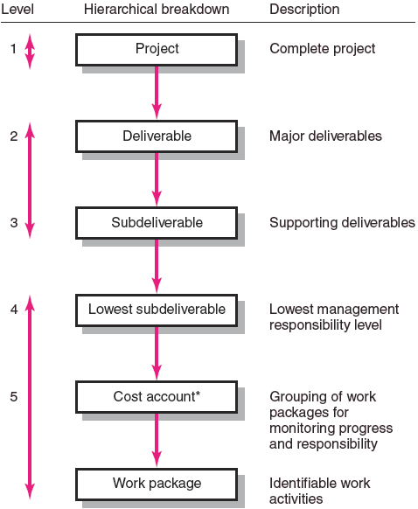
Hierarchical breakdown of the WBS
from: Gray & Larson (2008). Project management: the managerial process (4th ed.) McGraw-Hill Irwin.
FIGURE 4.3

Slide 9
How does the WBS help the PM?
Facilitates evaluation of cost, time, and technical performance of the organization on a project
Provides management with information appropriate to each organizational level
Helps in the development of the organization breakdown structure (OBS), which assigns project responsibilities to organizational units and individuals
Helps manage plan, schedule, and budget
Defines communication channels and assists in coordinating the various project elements

Slide 10
An Example …
Project 09102: House Construction
LEVEL
Site preparation
Exterior
Utilities
Interior
Foundation
Exterior walls
Landscape
Electrical
HVAC
Plumbing
FIGURE 4.4
Notes:
fill in interior:
living areas
kitchen
baths

Slide 11
Work packages
A work package is the lowest level of the WBS.
  It is output-oriented in that it:
    Defines work (what)
    Identifies time to complete a work package (how long)
    Identifies a time-phased budget to complete a work package (cost)
    Identifies resources needed to complete a work package (how much)
    Identifies a single person responsible for units of work (who)

Slide 12
Step 4: Coding the WBS
WBS Coding System
  Defines:
    Levels and elements of the WBS
    Organization elements
    Work packages
    Budget and cost information
  Allows reports to be consolidated at any level in the organization structure.

Slide 13
WBS coding
09102: House Construction
  09102.1 Site preparation
  09102.2 Exterior
    09102.2.1 Foundation
    09102.2.2 Exterior walls
    09102.2.3 Landscape
  09102.3 Utilities
    09102.3.1 Electrical
    09102.3.2 HVAC
    09102.3.3 Plumbing
etc.

Slide 14
Your turn …
To start your project, you should define the WBS
  What are the deliverables, subdeliverables, and work packages required to deconstruct Ware Hall?
We will discuss these in class on Thursday.

Slide 15
Step 5: Develop activities, cost, & schedule
Activities developed from work packages
  Identify distinct, separable tasks that have to be done to complete the work package
  Associate a duration with each task
  Identify resources required
    People
    Equipment
    Facilities
  Identify “precedence”
    What has to happen before this task can be started?

Slide 16
Recall our house example …
Tasks that need to be completed for each work package, e.g.
  Electrical utilities are installed in two main tasks
    Rough in electrical
    (and, after drywall is installed)
    Finish electrical
  Other work packages are similarly decomposed into activities, as shown on the next slide

Slide 17
Our example …
Task Definition:
Description Duration(days) Precedence
Step A: Prepare site. 5 -
Step B: Build foundation. 8 A
Step C: Frame walls and roof. 15 B
Step D: Rough in Plumbing 12 C
Step E: Rough in Electrical 10 C
Step F: HVAC Venting 8 C
Step G: Drywall 11 D,E,F
Step H: Finish Electrical 5 G
Step I: Finish Plumbing 4 G
Step J: Finish HVAC 2 H
Step K: Install Kitchen 8 H,I
Step L: Install Baths 14 H,I
Step M: Paint 5 J,K,L
Step N: Landscape 5 J,K,L

Slide 18
Project Management
Precedence Diagram
Tasks must sometimes be performed in series, or may at times be performed in parallel.
For the house example, let each node represent a project task/job.
J
D
H
M
K
A
B
C
E
G
I
N
L
F

Slide 19
Project Management
Timing – Gantt Chart
Tasks and task durations are often represented as Gantt Charts.
Task precedence knowledge is shown graphically on the time line.
Task Name | Duration |  | Nov 09,15 |  |  |  |  |  | Nov 16, 15
 |  |  | M | T | W | T | F |  | M | T | W | T | F

Slide 20
Project Management
Critical Path
J
D
H
M
K
A
B
C
E
G
I
N
L
F

Slide 21
Expediting/Crashing
CPM – Critical Path Method
Can normal task times be reduced?
Is there an increase in direct costs?
  Additional manpower
  Additional machines
  Overtime, etc…
Can there be a reduction in indirect costs?
  Less overhead costs
  Less daily rental charges
  Bonus for early completion
  Avoid penalties for running late
  Avoid cost of late startup
CPM addresses these cost trade-offs.

Slide 22
CPM – Critical Path Method
Example:
Overhead cost = $5/day
Step 1. Draw the precedence diagram
Notes:
Note: we will use “activity on arcs”

Slide 23
CPM – Critical Path Method
Precedence diagram & critical path
A
D
F
H
B
C
E
G
Enumerative Approach:
Reduce job H by 1 day: Total cost improves by ________________
Reduce job A by 2 days: Total cost improves by ________________
Notes:
Reduce job H by 1 day: Total Cost improves by $5 - $4 = $1.
Reduce job A by 2 days: Total cost improves by $10 - $8 = $2.

Slide 24
CPM – Critical Path Method (cont.)
A
D
F
H
B
C
E
G
Reduce job A by an additional day and job B by 1 day?:
Total cost improves by ________________
Reduce job A by an additional day and job C by 1 day?:
Total cost improves by ________________
Notes:
Reduce job A by an additional day, and job B by a day? Total cost
improves by $5 - $4 - $2 = -$1. Therefore do not take this action.
Reduce job A by an additional day, and job C by a day? Total cost
improves by $5 - $4 - $2 = -$1. Therefore do not take this action.

Slide 25
CPM – Critical Path Method (cont.)
A
D
F
H
B
C
E
G
Evaluate combinations of reducing path 3-4-6 and 3-5-6 by one day.
Overall improvement = ______________________________
Notes:
Evaluate combinations of reducing path 3-4-6 and 3-5-6 by one day.
D & E = $5 - $3 - $3 = -$1 F & E = $5 - $5 - $3 = -$3
D & G = $5 - $3 - $1 = $1 F & G = $5 - $5 - $1 = -$1
Therefore, reduce job D & G by 1 day: TC improves by $5 - $3 -$1 = $1.
Overall improvement: $1 + $2 + $1 = $4.

