Slide 1
Henry Ford Health System
Leadership
By: Isabella Connor, Marvin Davis and Kate Thomas

Slide 2
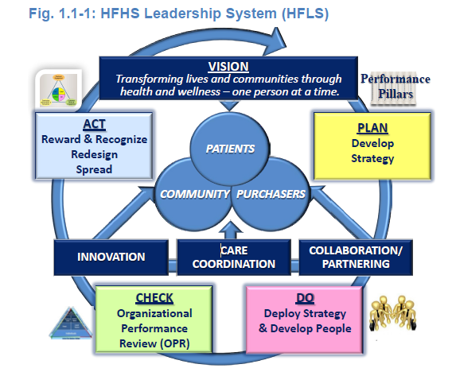
Senior Leadership
Vision and Values
Vision Subteam (2010)
Leadership System
Promoting Legal and Ethical Behavior
Environment that fosters ethical behavior
CEO led ethical processes
Vendor Compliance Policy
Creating a Sustainable Organization
System and pillar teams
Organizational and workforce learning
Patient safety culture
Isabella Connor, Marvin Davis and Kate Thomas 2/8/16

Slide 3
Senior Leadership (cont.)
Communication
Two-way exchange:
Face-to-face, print and email communications
Blogs and vodcasts
Key Decisions:
Consistent messages are integrated into all of the workforce segments
Role in recognition:
Recognition and personal thank-yous for outstanding communication
measured by the Employee Engagement Survey and leade 360° feedback
Focus on Action
Action plans milestones and targets are cascaded from managers to the workforce
Performance measures are monitored and altered if measures are not met
Isabella Connor, Marvin Davis and Kate Thomas 2/8/16

Slide 4
Governance and Societal Responsibilities
Governance and Societal Responsibilities:
The BOT provides oversight to the HFHS by the following ways:
Accountability for management's actions
Fiscal accountability
Transparency in operations
Independence of internal and external audits
Protection of stakeholder interests
Performance Evaluation:
All employees are evaluated based on team member standards.
Legal Behavior, Regulatory Behavior, and Accreditation
HFHS addresses potential societal, legal, regulatory and environmental impacts from its services and operations.
Isabella Connor, Marvin Davis and Kate Thomas 2/8/16

Slide 5
Governance and Societal Responsibilities (cont.)
Ethical Behavior
Code and Conflicts of Interest (COI) Disclosure Process
Education at employee orientation
Mechanism for the workforce to share concerns and ask questions
Proactively addressing regulatory and legal requirements
Societal Well-Being
Looks for gaps in services, demographic, market and technology
Economic Engine that contributes to employees and families well-being
Training healthcare staff and funding research
Community Support
Strengthen community
Community Pillar Team (CPT)
Insurance assistance
Isabella Connor, Marvin Davis and Kate Thomas 2/8/16

Slide 6
Conclusion
Predominantly value based
Leadership and Ethics are inherent throughout the entire company.
Immense focus on communication and action
Focus on responsibility and accountability
Helps and strengthens the community
Isabella Connor, Marvin Davis and Kate Thomas 2/8/16

