Slide 1
FLP Corrugated Waste Disposal Project
Prepared by:
Riley Chapman (ISE)
Trevor O’Connor (IDM)
Derrick Whitfield (IDM)

Slide 2
FLP Corrugated Waste Disposal:
Introduction
Current waste disposal process involves two methods:
  Disposal of cardboard boxes deemed “unusable” (SOP that labor is based on)
    Disposed by crushing boxes by use of a baler
    Transported to 53’ container after boxes have been baled
  Disposal of corrugated cores
    Generated during bagging process and stored in multiple locations of plant
    Much harder material; much harder to dispose of
    Stored in multiple bins on site
    Transported by 3rd party contractor to dispose of material

Slide 3
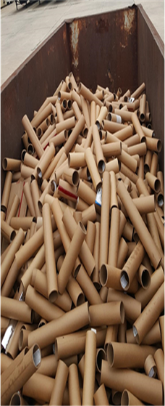
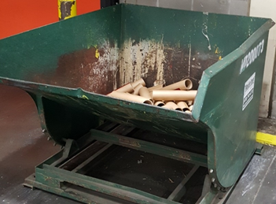
FLP Corrugated Waste Disposal:
Project Description

Slide 4
FLP Corrugated Waste Disposal:
Project Description-Continued
Client’s Deliverables
  10% increase in labor efficiency of the waste process
    Reduction of time spent in waste disposal process
  10% cost savings compared to current disposal/recycling method
  Recommendation of improvement to current systems and processes

Slide 5
FLP Corrugated Waste Disposal:
Design Specifications
Alternative Designs
  Refurbish into “Green” consumer product
  Return to Vendor program (RTV)
  Reengineering of process and equipment

Slide 6
FLP Corrugated Waste Disposal:
Feasibility Criteria
Time
  Scope: Aims to increase labor efficiency by 10%
Cost
  Scope: Aims to reduce the cost of waste disposal process by 10%
Internal Process
  Scope: Aims to control process in on-site environment
Space Constraint
  Scope: Aims to keep project contained within 1,600 square feet

Slide 7
FLP Corrugated Waste Disposal:
Merit Analysis
Refurbish into “Green” Consumer Product
Return to Vendor (RTV)
Reengineering of Process
 | Weight | Factor | Total Score
Cost | 0.50 | 8 | 4
Internal Process | 0.25 | 2 | 0.5
Labor | 0.15 | 0 | 0
Space | 0.10 | 5 | 0.5
Total |  |  | 5
 | Weight | Factor | Total Score
Cost | 0.50 | 3 | 1.5
Internal Process | 0.25 | 9 | 2.25
Labor | 0.15 | 8 | 1.2
Space | 0.10 | 10 | 1
Total |  |  | 5.95
 | Weight | Factor | Total Score
Cost | 0.50 | 9 | 4.5
Internal Process | 0.25 | 8 | 2
Labor | 0.15 | 7 | 1.05
Space | 0.10 | 9 | 0.9
Total |  |  | 8.45

Slide 8
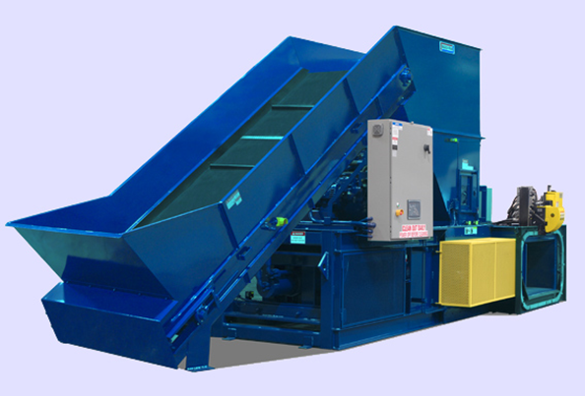
FLP Corrugated Waste Disposal:
Conclusion

