Slide 1
2012 Malcolm Baldridge Award Recipient (Manufacturing)
Lockheed Martin- Preface
Dan Pirovano
Daniel Reveles
Ben Spears

Slide 2
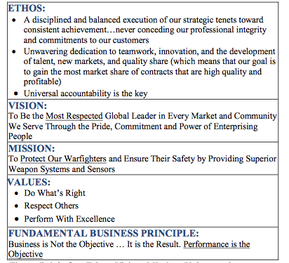
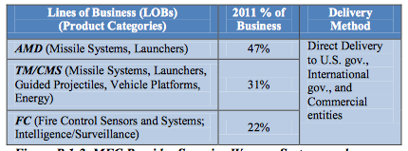
Organizational Environment
Fire and Missile Control is one
of Lockheed Martin’s 5 business
areas.

Slide 3
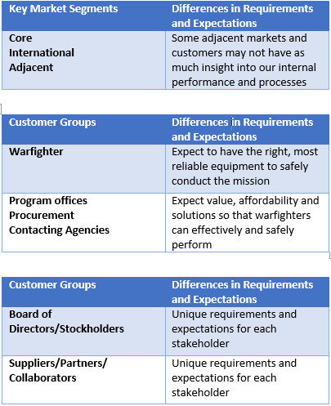
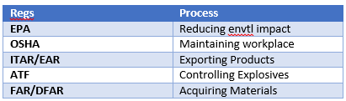
Organizational Relationships
Customers and Stakeholders
Organizational Structure
Suppliers and Partners
  1500 Suppliers, collaborators, and partners

Slide 4
Competitive Environment
Four Major Competitors: Raytheon, Boeing, Northrop Grumman and ATK
Simultaneously competing against and working with on different projects.
Competitive orders have increased in the past decade, and will be up to 60% of total orders in 5 years
Mergers, collaboration, technology, and innovation have impacted the competitive environment
Lockheed martin constantly tracks data in the industry that may impact the business

Slide 5
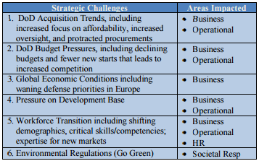
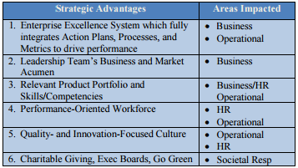
Strategic Context

Slide 6
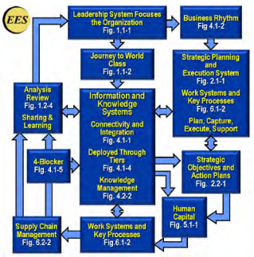
Performance Improvement System
Commitment to continuous process improvement and management (Dynamic System)
All executives trained in LSS Green, Black, and Master Black Belts responsible for change
Latest evolution in EES is EPI
(Enterprise Performance Metric)
Allows for analysis and prediction
to contribute value added results

Slide 7
Citation
http://patapsco.nist.gov/Award_Recipients/PDF_Files/2012_Lockheed_Martin_MFC_Application_Summary.pdf
All text in in quotation marks taken directly from the application.

