Slide 1

Lean Delivery
Brady Bradshaw
Alex Byrd
Alesia Ginn
Austin Herrmann
David Murtaugh
Aaron Odom
Josiah Wright
http://mlerfi.org/about/history/

Slide 2
Introduction
In 2007, Mercy Hospital St. Louis joined forces with General Electric’s healthcare division.
Mercy Hospital St. Louis was able to cut down on wasted time and increase on-time surgeries and other procedures by employing LEAN Six Sigma strategies, daily huddles, and incorporating the employees in the improvement process.
The hospital also invested in value stream ownership and analysis, which involves a lean specialist who devotes up to 50% of his/her time to that value stream or service line.
2/29/16 ETM 528 Lean Delivery - Bradshaw,Byrd,Ginn,Herrmann,Murtaugh,Odom,Wright

Slide 3
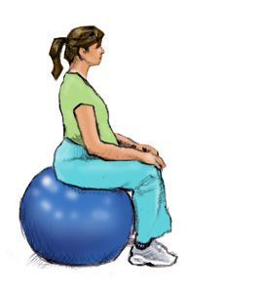
Patient Interaction
Mercy Birth and Labor
Provide 24/7 pain management care
Mercy has a Level III (highest level) Neonatal Intensive Care Unit (NICU) ready to address any newborn-related health concerns
Deliver more than 8,000 newborns every year.
A shower with built-in chairs and massaging jets are located in every room.
Birthing balls, which help open the pelvis and provide comfort, are located in every room
http://www.babycentre.co.uk/l1045054/using-a-birth-ball-photos
2/29/16 ETM 528 Lean Delivery - Bradshaw,Byrd,Ginn,Herrmann,Murtaugh,Odom,Wright

Slide 4

Huddle Up
Daily staff huddles take place at Mercy Health System
Over 10 administration huddles and 250 co-worker huddles every day
Innovation Boards include improvement ideas, payoff matrix, just-do-its
Just-do-its are improvements that can be made in three or fewer steps/days
https://www.teepublic.com/show/208840-just-do-it
2/29/16 ETM 528 Lean Delivery - Bradshaw,Byrd,Ginn,Herrmann,Murtaugh,Odom,Wright

Slide 5
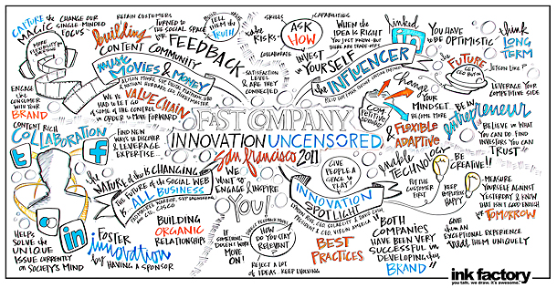
Huddle Up (con’t)
Innovation Boards focus on metrics that indicate current status related to goals for each team
Metrics are color coded red or green and follow five-by-five rule for quick analysis
Over 3,500 ideas have been generated through huddle up meetings
http://inkfactorystudio.com/graphic-recording/fast-company/
2/29/16 ETM 528 Lean Delivery - Bradshaw,Byrd,Ginn,Herrmann,Murtaugh,Odom,Wright

Slide 6

Leading in a Lean Environment
New leadership program being designed by Mercy to train leaders for a Lean Process company
Topics include:
  art of asking questions
  how to be a coach
  mentor and facilitator
  abandoning traditional autocratic leadership styles
Also stresses daily improvement through huddles, status boards, and standardized calendars
http://www.deafservicesunlimited.com/2015/03/huddle-up-protecting-the-message/
2/29/16 ETM 528 Lean Delivery - Bradshaw,Byrd,Ginn,Herrmann,Murtaugh,Odom,Wright

Slide 7
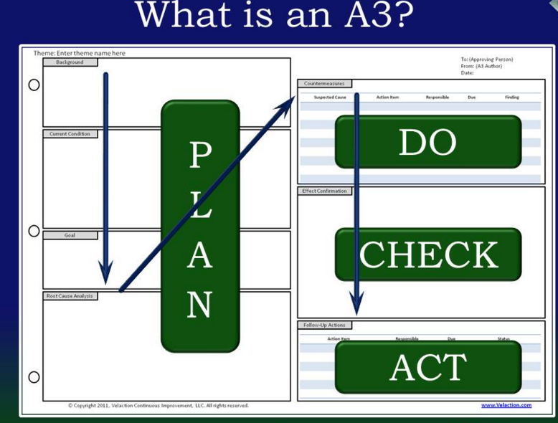
The Lean Process
Hot Points:
With a desire to grow larger, Mercy Hospital St. Louis challenged patient and staff processes.
Took a 9-month journey to figure out ways to fix current process through RIE, lean fundamentals and A3 thinking.
The middle of the week would be a time to try new solutions and observe results.
By end of each week, group was ready to report its observations, solutions and plan for implementation.
http://www.velaction.com/a3-thinking/
2/29/16 ETM 528 Lean Delivery - Bradshaw,Byrd,Ginn,Herrmann,Murtaugh,Odom,Wright
Notes:
The A3 Report provides a concrete structure to implement PDCA Management. It helps draw the report author(s) to a deeper understanding of the problem or opportunity and how to address it

Slide 8

SIPOC
Stands for:
Suppliers
Inputs
Processes
Outputs
Customers
http://epcb.blogspot.com/2011/12/three-steps-to-developing-sound-sipoc.html
2/29/16 ETM 528 Lean Delivery - Bradshaw,Byrd,Ginn,Herrmann,Murtaugh,Odom,Wright

Slide 9
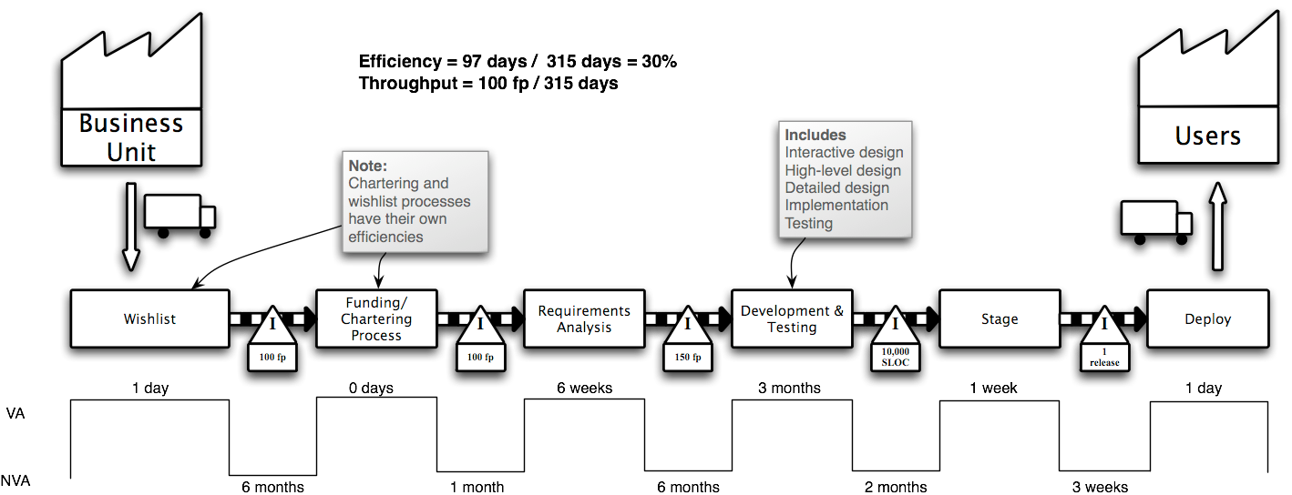
Value Stream Map
Value stream mapping is a method for analyzing the current state and designing a future state for the series of events that take a product or service from its beginning through to the customer.
https://lostechies.com/andrewsiemer/2016/01/07/value-stream-map/
2/29/16 ETM 528 Lean Delivery - Bradshaw,Byrd,Ginn,Herrmann,Murtaugh,Odom,Wright

Slide 10
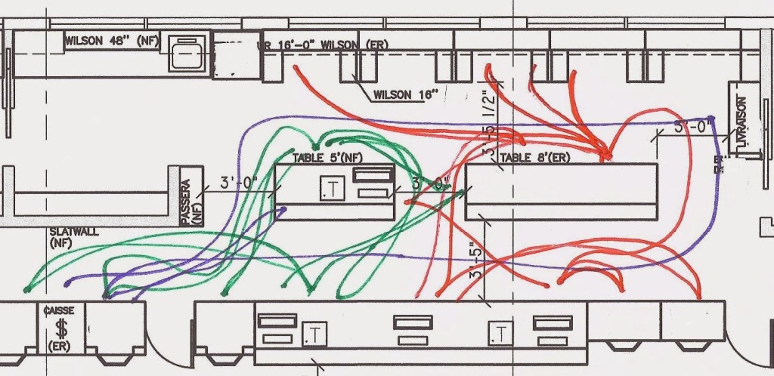
Spaghetti Charts
What is a Spaghetti Chart?
A spaghetti chart is a visual representation using a continuous flow line tracing the path of an item or activity through a process.
http://diagrama.xyz/spaghetti-diagram/
2/29/16 ETM 528 Lean Delivery - Bradshaw,Byrd,Ginn,Herrmann,Murtaugh,Odom,Wright

Slide 11
Spaghetti Charts (con’t)
Spaghetti charts revealed that:
nurses were walking an average of more than 620 steps for each birth to different stations
staff members were walking an average of 367 steps and spending 11 minutes gathering supplies for newborn admissions
Solutions implemented:
Created a one-stop location where nurses could document, send bloodwork to lab, and submit paperwork. This decreased steps and time by 81%
Created a caddy to hold all the needed supplies in one place which decreased steps and time by 60%
2/29/16 ETM 528 Lean Delivery - Bradshaw,Byrd,Ginn,Herrmann,Murtaugh,Odom,Wright

Slide 12
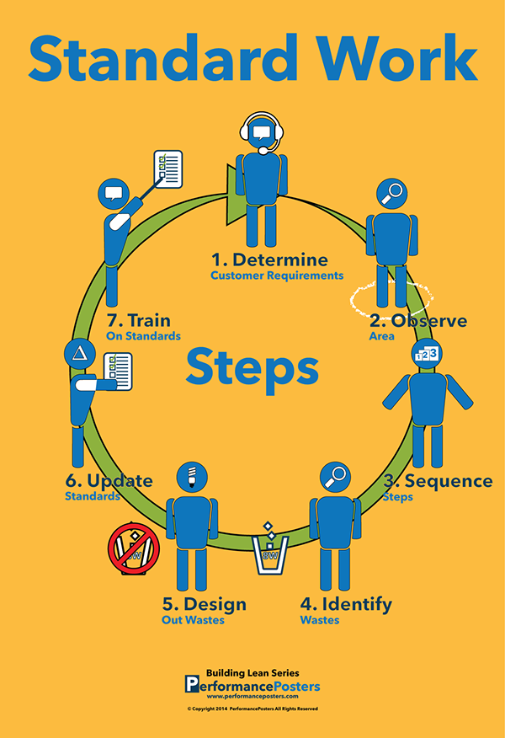
Standard Work
Standard work (standard operating procedures) are instruction sheets that ensure all workers follow the same procedures the exact same way, reducing errors and variability.
https://www.behance.net/gallery/18566529/Standard-Work-Poster-Building-Lean-Series
2/29/16 ETM 528 Lean Delivery - Bradshaw,Byrd,Ginn,Herrmann,Murtaugh,Odom,Wright

Slide 13
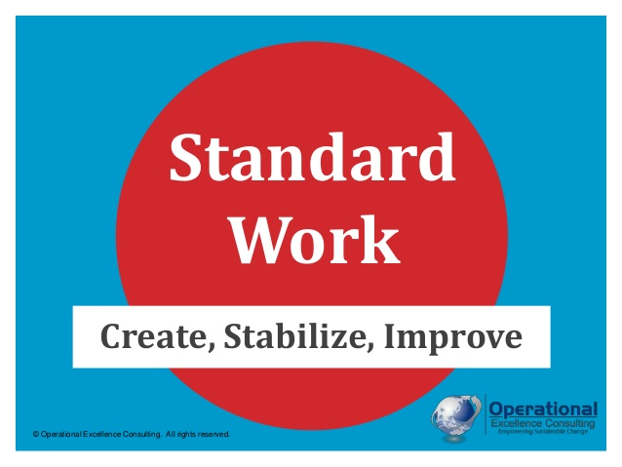
Standard Work
Mercy began using standard work for calling patients, assigning rooms, and preparing rooms, as well as for technical tasks such as baby delivery.
Standard work saved up to an hour per patient for nurses and anesthesia providers, and saved up to 48 minutes per patient for reporting.
http://www.slideshare.net/oeconsulting/standard-work-by-operational-excellence-consulting
2/29/16 ETM 528 Lean Delivery - Bradshaw,Byrd,Ginn,Herrmann,Murtaugh,Odom,Wright

Slide 14
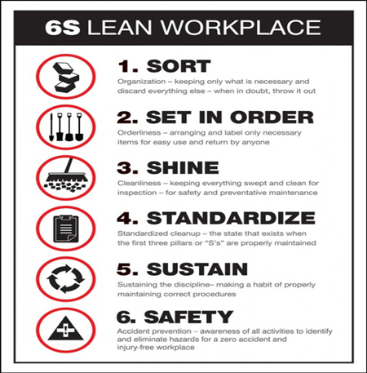
6S
https://www.accuform.com/files/damObject/Image/huge/PST835hires.jpg
Sort
Forms that were no longer needed were recycled
Set in Order
Equipment rooms were taped to mark where items should be stored
Shine
Every inch of the unit was scrubbed down
Standardize
Update metrics daily to show adherence to standards
Sustain
Standard protocols were written down so that the other S’s can be sustained
Safety
Equipment closets reorganized so that staff can navigate the rooms safely
https://www.accuform.com/files/damObject/Image/huge/PST835hires.jpg
2/29/16 ETM 528 Lean Delivery - Bradshaw,Byrd,Ginn,Herrmann,Murtaugh,Odom,Wright

Slide 15
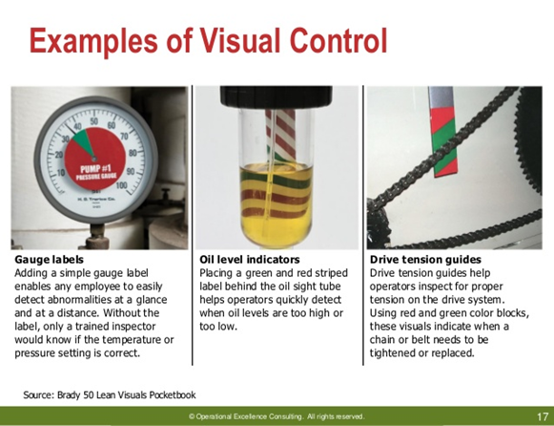
Visual Controls
Visual Controls use visual signs instead of text
Minimizes recognition time for employees and allows the results of random audits to be displayed to employees daily
http://image.slidesharecdn.com/previewoecvisualtoolsv104-2014-140420094932-phpapp02/95/visual-management-by-operational-excellence-consulting-17-638.jpg?cb=1433774068
2/29/16 ETM 528 Lean Delivery - Bradshaw,Byrd,Ginn,Herrmann,Murtaugh,Odom,Wright

Slide 16
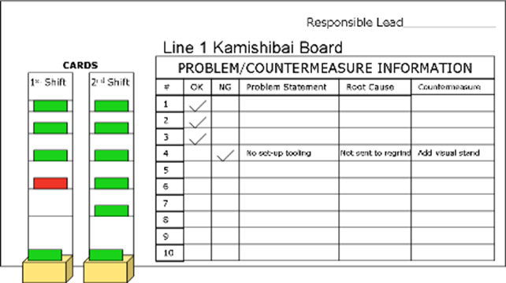
Kamishibai Cards
Visual Control used to show results of a random audit
Red side displays that the audit has failed or needs improvement
Green side exhibits that the audit has passed or is within the acceptable range
Mercy Hospital St. Louis uses Kamishibai Cards to inform staff members whether the changes are being sustained
https://kaizeninstituteindia.wordpress.com/2013/05/03/kamishibai/
2/29/16 ETM 528 Lean Delivery - Bradshaw,Byrd,Ginn,Herrmann,Murtaugh,Odom,Wright

Slide 17
Project Outcomes
Labor and birth unit underwent significant improvements in a variety of areas, increasing patient and physician satisfaction:
METRIC | BEFORE (%) | AFTER (%) | SOLUTION
Inductions called on time | 47 | 98 | Created standard time after first RIE
Operating room cases started on time | 52 | 74 | Add-on team from staff already slated as additional resources for last-minute cases
Recovery times two hr goal | 29 | 50 | Train RN’s to perform epidural instead of waiting for the anesthesiologist
2/29/16 ETM 528 Lean Delivery - Bradshaw,Byrd,Ginn,Herrmann,Murtaugh,Odom,Wright

Slide 18
Future Improvement
GE’s team left the hospital with a process that allowed for continuous improvement and also with the confidence (which comes from exposure to new ideas, experience, science materials, and training) to sustain the project. For example:
  the daily huddles
  A3 thinking
  co-worker involvement
  constantly seeking new improvement opportunities, contributing to the empowerment of the staff as time goes on
2/29/16 ETM 528 Lean Delivery - Bradshaw,Byrd,Ginn,Herrmann,Murtaugh,Odom,Wright

Slide 19
Related Lean Principles
A3 Thinking - systematic way to create improvements in the workplace, famous from Toyota; also creating a culture of improvement in a company
  Married to Plan-Do-Act-Check
Standard Work - 5W’s and 1H; collecting data and information on the current best practices and then applying those same practices across the organization
  then further improvements can be made to the process from the results of the standardize work.
Training - in this case, training eliminated down time, but training also prevents lost knowledge, and increases quality, efficiency and “operator” error, which could lead to botch products or services.
2/29/16 ETM 528 Lean Delivery - Bradshaw,Byrd,Ginn,Herrmann,Murtaugh,Odom,Wright

Slide 20
Questions?
Comments?
2/29/16 ETM 528 Lean Delivery - Bradshaw,Byrd,Ginn,Herrmann,Murtaugh,Odom,Wright

