Slide 1
IDM Alumni Snapshots
ISE Alumni Snapshots
Compiled by Dr. Joan Burtner
Chair, Department of Industrial Engineering and Industrial Management
February 2019

Slide 2
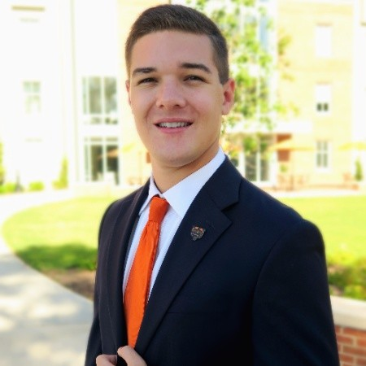
Alan Howard
Inventory and Systems Specialist
Irving Tissue
Macon, GA (area)
BSE 2018
  Mercer Univ. School of Engineering
  Industrial Engineering specialization
MSE 2019
  Mercer Univ. School of Engineering
  Engineering Management
Internships
  VTC Production Intern – Hitachi Automotive Systems , Norcross, GA Summer 2017
  Manufacturing Engineer Intern – Blue Bird Corporation, Ft. Valley, GA Fall 2017 Spring 2018
Awards/ Activities
  Study Abroad – University of Sussex 2016
  2018-2019 IISE Society of Health System’s Scholarship Winner - Selected based on academic merit and essay entitled “Industrial Engineering in Healthcare: Improving Processes in Healthcare”
  2017 IISE Lean Manufacturing Student Paper Competition 2nd place “Manufacturing Process Improvement on Valve Control Timing Production”
Certifications
  IISE Six Sigma Green Belt Spring 2018
Irving Tissue
  June 2018 – Present
  Current Position: Inventory and Systems Specialist
Source: LinkedIn – March 2018

Slide 3
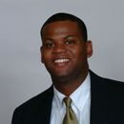
Dericus Harvey
Business Consultant
Chick - fil - A
Atlanta , Georgia
BSE 1999
  Mercer University School of Engineering
  Industrial Engineering
  Chief Justice, Mercer Judicial System
MBA Finance 2004
  Indiana University – Kelley School of Business
Automotive Industry
  General Motors (Production Supervisor 1999-2000)
  Ford Motor Company (Manufacturing Engineer 2000-2002)
Johnson & Johnson
  Senior Brand Analyst – Commercial Finance 2004-2005
  Senior Financial Analyst - WW Supply Chain 2005-2007
  Finance Manager – WW Business Development 2007-2008
  Manager – Domestic Treasury 2008-2011
Chick-fil-A
  Business Consultant, February 2011 to present
Source: LinkedIn Oct 2016

Slide 4
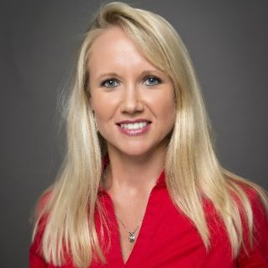
Kasie Jenkins
Sr. Manager, Final Phase Operations
Gulfstream Aerospace
Long Beach, CA
BS 2004
  Mercer Univ. School of Engineering
  Industrial Management major
MBA 2006
  Georgia Southern University GPA 4.0
Certifications
  Lean Six Sigma Green Belt
  Certified Project Manager
Career Path at Gulfstream (Savannah)
  Industrial Engineer 2003-2006
  Initial Phase Operations Manager 2006-2010
  Final Phase Operations Manager 2010-2013
Career Path at Gulfstream (California)
  Senior Manager, Final Phase Operations 2013 to present

Slide 5
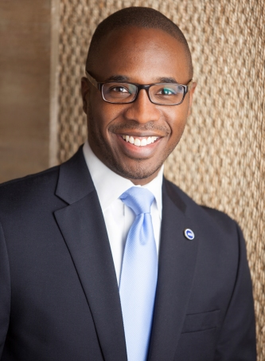
Kirk A. Nooks
President
Gordon State College
Barnesville, GA
BS 1996
  Mercer Univ. School of Engineering
  Industrial Management major
MBA
  Mercer Univ. Stetson School of Business
  Marketing
Engineering Career Path
  Warner Robins Air Logistics Center
Ed.D.
  George Washington University
  Higher Education Administration
Higher Education Administration Career Path
  Prince George’s Community College
  Northern Virginia Community College
  Georgia Highlands College
  Metropolitan Community College
  Gordon State College, President
    June 2018 - present
Source: www.usg.edu

Slide 6
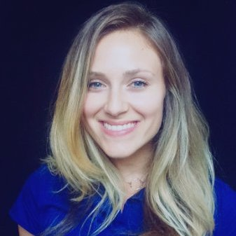
Jamie Duffy Gollon
Process Improvement Engineer
University Health Care System
Augusta, GA
BSE 2013
  Mercer University School of Engineering
  Industrial Engineering
MSE 2014
  Engineering Management
  Mercer University School of Engineering
  Master’s Thesis: Anthropometry of Lower Limbs in the Mekong River Delta Region of Vietnam and its Implications for Fitting Prosthetics (Dr. Laura Moody, Thesis Advisor)
Career Path
  Systems Redesign Intern, VA Long Beach Health Care System, Long Beach, CA. 2014
  Packaging Design Intern, Spectrum Brands, Middleton, WI. 2014-2015
  777 Occupational Health and Safety Specialist, Boeing, Everett, WA. Feb 2015 to Aug 2016
  Process Improvement Engineer, University Health Care System, Augusta, GA. 2016 to present

Slide 7
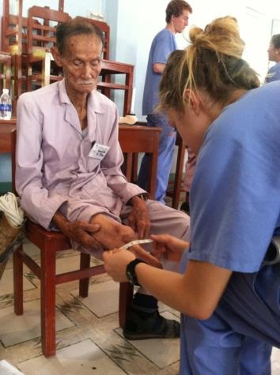
Jamie Duffy - BSE Industrial Engineering, MSE Engineering Management
Process Improvement Engineer
University Healthcare System
Augusta, GA
Dr. Laura Moody, Associate Professor of Industrial Engineering: “Jamie’s experience with Mercer On Mission to Vietnam produced a real and apparent difference in her outlook and focus. One concrete result was her Master’s thesis researching the anthropometry of the lower limbs of Vietnamese amputee patients. Using patient data she collected while in Vietnam, along with additional data provided by Dr. Vo, she evaluated the effect of age, gender, injury type, and region on the lower limb. Based on her analysis of the anthropometric data she developed concrete recommendations for the design and fitting of prosthetics for patients in the Mekong River Delta region. It also helped her to understand that a career in the healthcare field would be a good fit for her. “ (personal communication October 2018)
Jamie Duffy in Vietnam collecting data for her master’s thesis

Slide 8
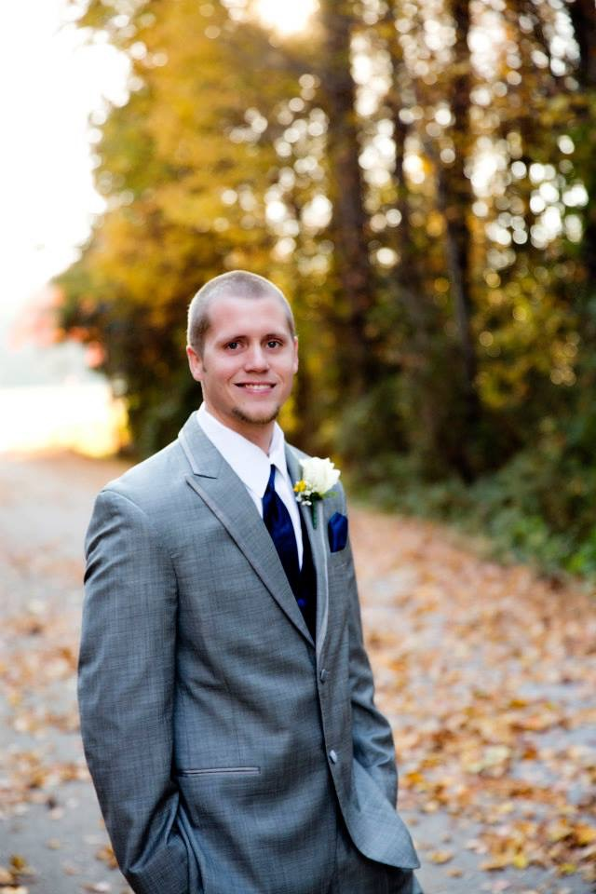
Russell Hazelrig
Reliability Engineer II Baxter International, Inc.
Covington, GA
BSE 2011
  Mercer Univ. School of Engineering
  Industrial Engineering
  Business Administration minor
Certifications
  Six Sigma Green Belt
  Six Sigma Black Belt
  Certified Quality Engineer (Automotive Industry)
  Certified Project Manager
Career Path
  SRG Global (Automotive)
    Industrial Engineer
    Quality Engineer
  Baxter (Healthcare)
    Reliability Engineer II

Slide 9
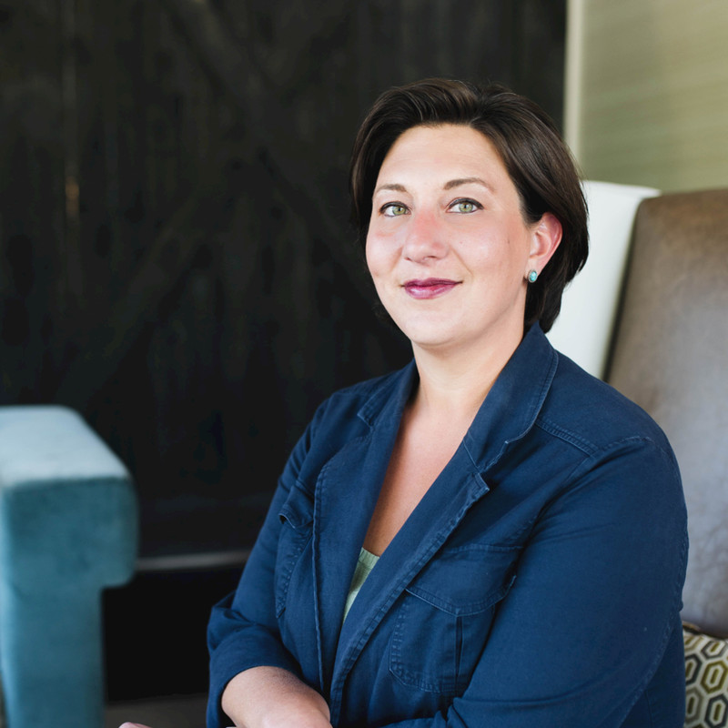
Susan Barkley
CEO, Founder
PHILEANTHROPY
Nashville, Tennessee
BSE 2000
  Mercer Univ. School of Engineering
  Industrial Engineering
MBA 2005 Wake Forest University
Member, Mercer University National Engineering Advisory Board
Career Path
  Medical Center of Central Georgia, Management Engineer Coop 1998-2000
  Carilion Health System, Management Consultant 2000-2004
  Premier, Inc. Senior Performance Engineer 2004-2006
  HCA Healthcare
    Director, Strategic Resource Group, 2006 -2010
    Corporate Director of Management Engineering 2010-2014
  State of Tennessee, Office of the Governor, Senior Management Consultant 2014- present
  CEO, Phileanthropy (www.phileanthropy.com)
Source: LinkedIn September 2018

Slide 10
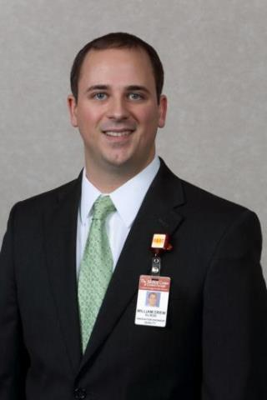
Drew Elrod
Chief of Staff
The Medical Center, Navicent Health
Macon, GA
BS 2007
  Mercer Univ. School of Engineering
  Industrial Management Major
MBA 2009
  Mercer University
Certifications
  CHFM, Certified Six Sigma Black Belt
Career Path at The Medical Center, Navicent Health (formerly The Medical Center of Central Georgia - MCCG)
  Hired as a co-op at MCCG during college
  Completed Senior Design project at MCCG
  Hired full-time in 2007 with the title Industrial Engineer
  Promoted to Innovation Engineer(2015)
  Promoted to Chief of Staff (2016)

Slide 11
Drew Elrod
Innovation Engineer The Medical Center, Navicent Health
Macon, GA
“Change in healthcare is happening at warp speed. Healthcare organizations must continuously reengineer the way they operate to remain competitive or risk becoming irrelevant. As the market consolidates, successful healthcare organizations are turning to engineers and those with an entrepreneurial spirit to redefine the service delivery model. Concepts such as simplification, fast work, process optimization and big data are integral to the healthcare value equation. Engineers are uniquely qualified to address the challenges facing the healthcare delivery system, and I believe you will see an employment surge for healthcare engineers in the future.”
(Dr. Joan Burtner, personal communication, March 2, 2015)

Slide 12
Drew Elrod
Innovation Engineer The Medical Center, Navicent Health
Macon, GA
  “I love being able to take on problems from departments all over the hospital and translate them into working solutions. I think it is fun that I get to think about problems in new and different ways from people in other departments. As a result, I am able to offer perspective and solutions that they often cannot see.”
  (Personal Communication with IDM student Whitney Boyer 2009)

Slide 13
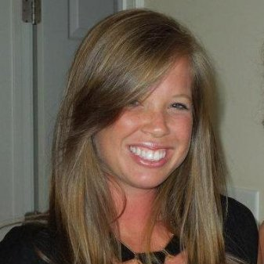
Stacey Odom
Sr. Management Engineer
Northside Hospital
Atlanta, GA
  BSE Industrial Engineering
    MUSE 2010
Mercer on Mission Clinic Volunteer (Viet Nam, Summer 2009)
  Performed clinical work such as giving injections, organizing paperwork, and assisted doctors during initial exams on patients
  Developed and optimized ergonomic work flow system to efficiently move patients through each clinic
Career Path
  Industrial Engineer, Robins Air Force Base. Warner Robins, GA 2010-2011
  Management Engineer, Northside Hospital, Atlanta,GA 2011-2014
  Senior Management Engineer, Northside Hospital, Atlanta,GA 2014-present

Slide 14
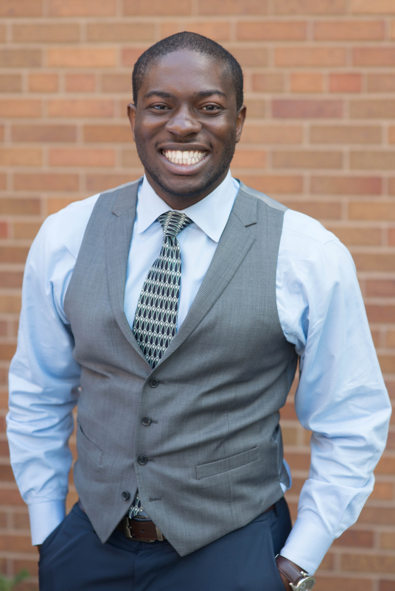
Ikechukwu Ekeke
Law Clerk
Cuyahoga County Prosecutor's Office
Cleveland, OH
BSE , MSE 2013
  Mercer Univ. School of Engineering
  BSE, Industrial Engineering
  MSE, Engineering Management
  Volunteer work
    Upward Bound Mentor and Tutor
    Be a Good Neighbear
Juris Doctor 2016
  Case Western Reserve University School of Law
  Intellectual Property Law
Career Path
  Law Clerk, Cuyahoga County Prosecutor’s Office
  August 2014 - present
Source: LinkedIn January 2017

Slide 15
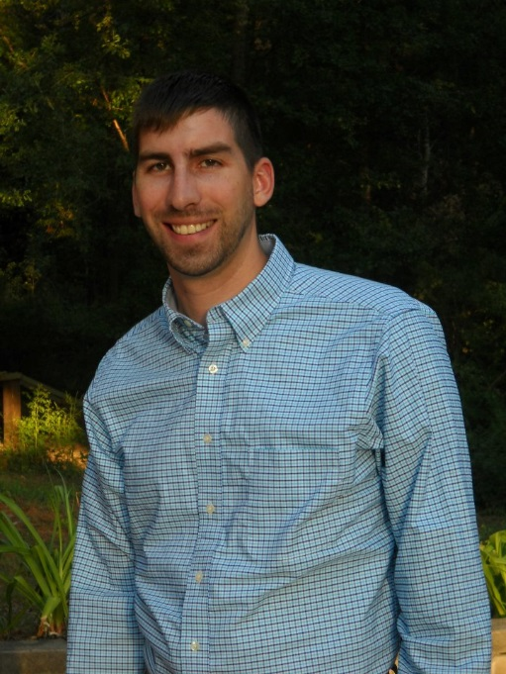
Ned F. Nobles
Project Management
ESG Operations, Inc.
Warner Robins, GA
BS MUSE 2014
  Industrial Management
“I was hired for a 3 month part time CAD job at ESG Operations over the summer and was asked to stay on full time 3 weeks later. ESG is an environmental engineering firm and utilities contractor that specializes in water and waste water but covers much more. I work mostly at the corporate office making construction plans and drawings in CAD or writing applications for permits. When I get a chance, I spend time in Warner Robins learning waste water and project management at the Sandy Run waste water plant. Besides a basic understanding of CAD and the Project Management class I attended at Mercer, what I do on a daily basis is new to me and was not part of my formal degree. My time at Mercer taught me to research, learn, and apply so that I can solve problems and make improvements regardless of the working environment.” (Dr. Joan Burtner, personal communication, Nov. 19, 2014)

Slide 16
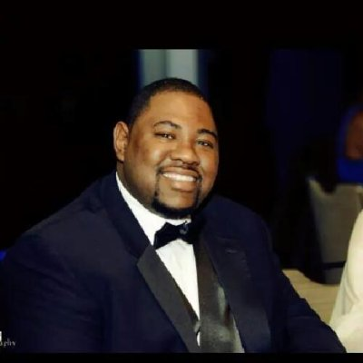
Morge Miller
Supplier Quality Engineer
The Coca Cola Company
Atlanta, GA
BSE 2004
  Mercer Univ. School of Engineering
  Industrial Engineering
MBA 2011
  Clayton State University
  Supply Chain Management
MS expected 2016
  Penn State University
  Finance
Career Path
  2005 A T & T
  2006 Lockheed Martin Aeronautics
  2008 Eaton Corporation
  2011 Ryder Integrated Logistics
  2013 Lockheed Martin Aeronautics
  2013 to present The Coca Cola Company

Slide 17
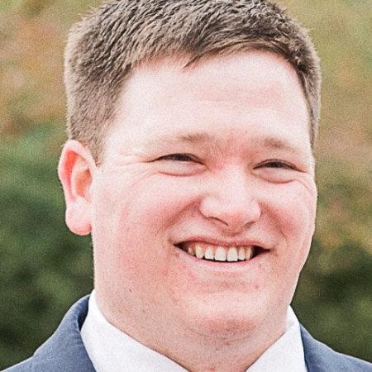
Alex McGinnis
Manufacturing Process Engineer
Kubota Manufacturing of America
Gainesville, GA
BS 2013
  Mercer University School of Engineering, Industrial Management
Career Path
  Manufacturing Process Engineer at Kubota Manufacturing of America Gainesville, GA June 2013 - present
LinkedIn Job Description “I support the flow of production as a Manufacturing Process Engineer at Kubota. Whether it involves a design or a process, I work to improve different areas and create solutions for the production of units to meet customer demand. I find more efficient ways for the workers to work on their process and participate in many Kaizen activities in the plant.” (August 2017)
Source: LinkedIn August 2017

Slide 18
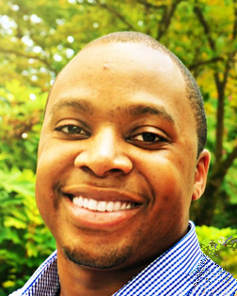
Marsalis Charles
Production Supervisor Manager
Tesla
Fremont, CA
  BSE Industrial Engineering,
  Mercer University 2014
Mercer on Mission Environmental Engineer - Uganda, (Summer 2013)
Six Sigma Black Belt (December 2016)
Career Path
  Industrial Engineer Intern, Blue Bird Corp. Fort Valley, GA 2013
  Industrial Engineer / Lean Expert, PAS Technologies, Hillsboro, OH 2014 - 2017
  Production Supervisor Manager, Tesla, Fremont, CA 2017-present

Slide 19
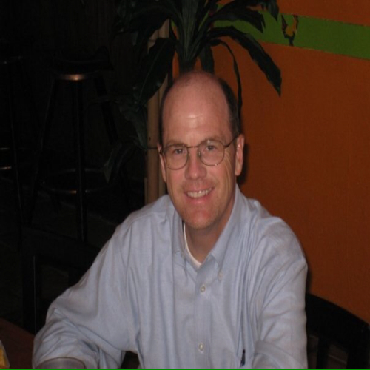
David Morey
Senior Performance Engineer
Phoebe Putney Health System
Albany, Georgia
BS 1999
  Mercer Univ. School of Engineering
  Industrial Management major
Certifications
  Lean Certification in Healthcare Projects
  Lean Six Sigma Green Belt
  Lean Six Sigma Black Belt
Career Path
  Medical Center of Central Georgia, Senior Management Engineer/ Management Engineer 1998-2001
  BMR General Contractors, Estimator/ General Contractor 2001-2009
  Premier, Inc. Senior Performance Engineer 2009-2012
  Phoebe Putney Health System, Senior Performance Engineer and Team Lead, 2012 to present
Source: LinkedIn September 2016

Slide 20
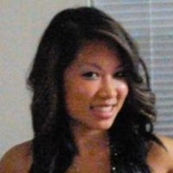
Jennifer Nguyen
High Level Controls Sales Engineer Vanderlande
Atlanta, GA
  BSE Industrial Engineering
    MUSE 2009
    Magna Cum Laude
    Tau Beta Pi
    Institute of Industrial Engineers
    Engineers without Borders
Career Path
  Warehouse Manager, Pepsico - Frito Lay 2009-2010
  Consultant, Manhattan Associates 2010-2013
  High Level Controls Sales Engineer, Vanderlande, 2015

Slide 21
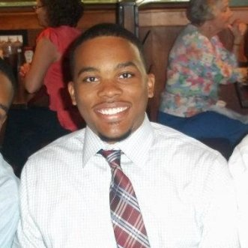
David Harris
Process Engineer
ALPLA Werke
Atlanta, Georgia
BSE 2011
  Mercer Univ. School of Engineering
  Industrial Engineering
  Engineering Excellence Award : Prosthetic Foot Design Project
Six Sigma Green Belt (Institute of Industrial Engineers) 2011
Career Path
  Blue Bird Corporation, Material Resource Planner, 2011
  General Dynamics, Manufacturing /Quality Engineer, 2012
  Flambeau, Project Engineer, 2012-2014
  ALPLA Werke, Process Engineer, 2014- present
Source: LinkedIn October 2016

