Slide 1
About Me – BioPoem
BioPoem:
  I chose ISE because of the older engineers I met and hearing their experience in this major.
  I enjoy meeting new people and making connections.
  I get in trouble when I stretch myself too thin between school, friends, and work.
  I have a habit of zoning out.
  I would like to be remembered as being witty and a genuinely nice person.

Slide 2
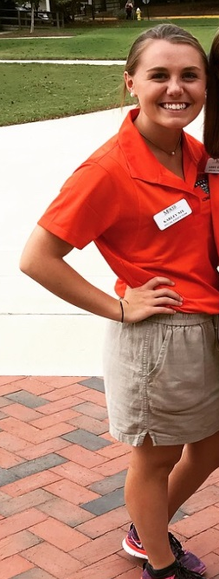
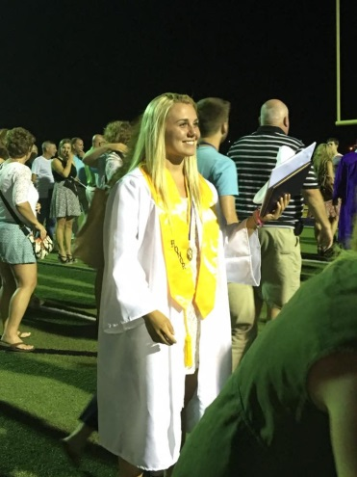
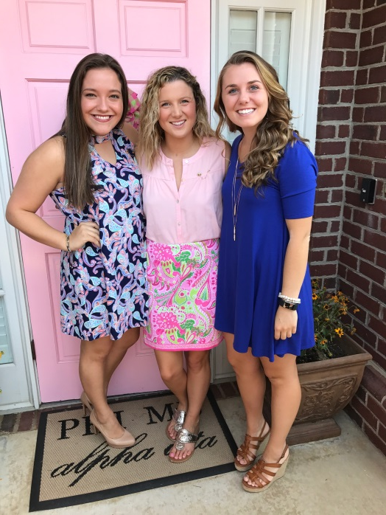
About Me - Pictures
Professional/Academic
Personal/Family
        This photo was taken while working for the admissions team at my first Saturday Preview.
  This photo was taken at my high school graduation.
  This photo is of a couple of my friends and I when we got back to school this past year.

