Slide 1
Henry Ford Health System: Customer Focus
By: Austin Herrmann and Vijay Patel

Slide 2
Voice of the Customer
Current Patients and Stakeholders
  Continuous and integrated process
  Leaders use the information to form Strategic Objectives, Strategic Initiatives and action plans
  Leadership and employees make rounds to assess patient’s well being and satisfaction
Potential Patients and Stakeholders
  Formally analyze surveys, and monitor demographic and market information and Health Alliance Plan member transfers
  Informally review media, press releases and competitor websites

Slide 3
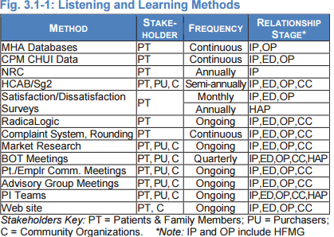
Voice of the Customer
BOT- Board of Trustees
C- Community Organizations
CC- Community Care
CHUI- Consumer Healthcare Utilization Index
CPM- Customer Potential Management
ED- Emergency Department
HAP- Health Alliance Plan
HCAB- Healthcare Advisory Board
IP- Inpatient
MHA- Michigan Health and Hospital Association
NRC- National Research Corporation
Sg2- Health care membership organization, providing clinical and technology research and consulting
OP- Outpatient
PI- Performance Improvement
PT-Patients and Family Members
PU- Purchasers

Slide 4
Voice of the Customer
Satisfaction and Engagement
  Infrastructure around Service Pillar to focus on Customer Engagement
    Tailored surveys for interactions with each department are sent to the patients
  Next day access to results to provide rapid identification of process improvement opportunities
Satisfaction Relative to Competitors
  Market research and focus groups
    Used to assess satisfaction with competitors, identify new service opportunities, and drive improvement
  Customer surveys
    Press Ganey (PG), Hospital Consumer Assessment of Healthcare Providers and Systems (HCAHPS) and Consumer Assessment of Healthcare Providers and Systems (CAHPS) provide competitor surveys for comparison

Slide 5
Customer Engagement
Health Care Service Offerings
  Identify new or improved service offerings to attract new patients.
  Prioritize opportunities for expanding relationships with existing patients & stakeholders
Patient & Stakeholder Support
  Design & improve mechanisms to support use of health care services.

Slide 6
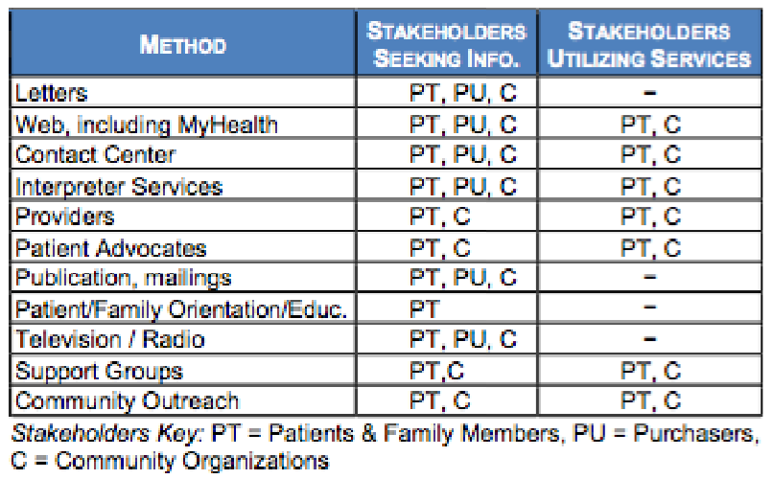
Patient & Stakeholder Support Mechanisms

Slide 7
Customer Engagement
Patient & Stakeholder Segmentation
  Identify market segments
    Analyze patient origin, employer group, service area demographics, and nationwide trends.
  Estimate potential patients in the market.
Patient & Stakeholder Data Use
  Provides data highly correlated with satisfaction to offer focus on service concerns.
  Targeted service offerings to patient segments

Slide 8
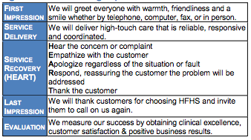
Customer Engagement
Relationship Management
  Identify key target audiences
  Develop growth & initiatives
  Design marketing plans

Slide 9
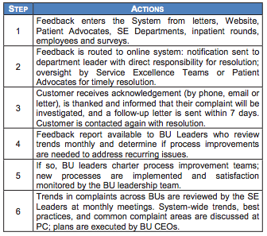
Customer Engagement
Complaint Management
  Feedback received in person, by phone, letter, e-mail or social media.
  Complaints initially handled at point of service with more severe complaints escalating to higher leadership levels.
  Feedback is aggregated, trended and analyzed
  SE- Service Excellence
  BU- Business Unit
  PC- Performance Council

Slide 10
Reference
http://patapsco.nist.gov/Award_Recipients/PDF_Files/2011_Henry_Ford_Health_System_Award_Application_Summary.pdf

