Slide 1
IDM487 Senior Design Project: Designing a Ukulele
By: Avery Ward
Team Members: Anna Stewart and Travonte’ Easley

Slide 2
Client and Technical Advisors
Client: Dr. Hodge Jenkins
Tech Advisors: Dr. Burtner and Dr. Afshar

Slide 3
Project Description
Develop a Ukulele design for simple manufacturing
Must be built using hand tools only
Design the most efficient manufacturing process
Budget = $300

Slide 4
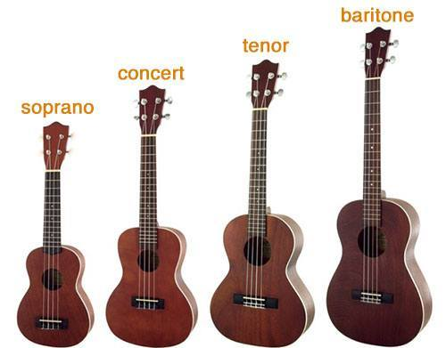
My Contribution
As an Industrial Management major, I will contribute to our team by helping design the manufacturing process
Avery Ward Senior Design IDM487 1/19/2018 3

