Slide 1
Henry Ford Health System
Leadership
By: Isabella Connor, Marvin Davis and Kate Thomas

Slide 2
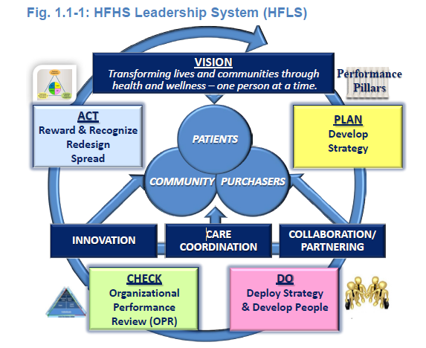
Senior Leadership
Vision and Values
  Vision Subteam (2010)
  Leadership System
Promoting Legal and Ethical Behavior
  Environment that fosters ethical behavior
  CEO led ethical processes
  Vendor Compliance Policy
Creating a Sustainable Organization
  System and pillar teams
  Organizational and workforce learning
  Patient safety culture
Isabella Connor, Marvin Davis and Kate Thomas 2/8/16

Slide 3
Senior Leadership (cont.)
Communication
  Two-way exchange:
    Face-to-face, print and email communications
    Blogs and vodcasts
  Key Decisions:
    Consistent messages are integrated into all of the workforce segments
  Role in recognition:
    Recognition and personal thank-yous for outstanding communication
    measured by the Employee Engagement Survey and leade 360° feedback
Focus on Action
  Action plans milestones and targets are cascaded from managers to the workforce
  Performance measures are monitored and altered if measures are not met
Isabella Connor, Marvin Davis and Kate Thomas 2/8/16

Slide 4
Governance and Societal Responsibilities
Governance and Societal Responsibilities:
  The BOT provides oversight to the HFHS by the following ways:
    Accountability for management's actions
    Fiscal accountability
    Transparency in operations
    Independence of internal and external audits
    Protection of stakeholder interests
Performance Evaluation:
  All employees are evaluated based on team member standards.
Legal Behavior, Regulatory Behavior, and Accreditation
  HFHS addresses potential societal, legal, regulatory and environmental impacts from its services and operations.
Isabella Connor, Marvin Davis and Kate Thomas 2/8/16

Slide 5
Governance and Societal Responsibilities (cont.)
Ethical Behavior
  Code and Conflicts of Interest (COI) Disclosure Process
  Education at employee orientation
  Mechanism for the workforce to share concerns and ask questions
  Proactively addressing regulatory and legal requirements
Societal Well-Being
  Looks for gaps in services, demographic, market and technology
  Economic Engine that contributes to employees and families well-being
  Training healthcare staff and funding research
Community Support
  Strengthen community
  Community Pillar Team (CPT)
  Insurance assistance
Isabella Connor, Marvin Davis and Kate Thomas 2/8/16

Slide 6
Conclusion
Predominantly value based
Leadership and Ethics are inherent throughout the entire company.
Immense focus on communication and action
Focus on responsibility and accountability
Helps and strengthens the community
Isabella Connor, Marvin Davis and Kate Thomas 2/8/16

