Slide 1
Henry Ford Health System Application Preface

Slide 2
Preface: Organizational Profile
Organizational Description
Service Offerings
Henry Ford saw the need for healthcare and started the Henry Ford Hospital and Henry Ford Medical Group a century ago.
Had opportunities to leave Detroit but committed, they created partnerships by adding ambulatory services in the suburbs.
Ranked in the top 6% of institutions granted funding by the National Institutes of Health.
Henry Ford Health Systems is a not-for-profit integrated health care delivery and insurance system.
9 business units including Henry Ford Hospital, Henry Ford Medical Group, and Health Alliance Plan (HAP).
Services are delivered for:
  Patients – through direct collaboration
  Community – through interactions through facility, website, media etc.
  Purchasers – through HAP’s insurance products

Slide 3
Preface: Organizational Profile
P.1a(2) Vision and Values
P.1a(3) Workforce Profile
Mission – to improve human life through excellence in the science and art of health care and healing.
Vision – transforming lives and communities through health and wellness – one person at a time.
Values – we serve our patients and our community through our actions that always demonstrate: Each Patient First, Respect for People, High Performance, Learning and Continuous Improvement, and a Social Conscience.
They developed the HFHS Team Member Standards
Core Competencies: Innovation, Care Coordination, and Collaboration/Partnering
More than 31,000 with 76% HFHS employees.
Incredibly diverse
More than 1,350 salaried HFMG physicians staff HFH and 30 ambulatory centers.
More than 2,200 private practice physicians.
1,500 physicians training annually
2,000 volunteers, about 6% of workforce handle customer service or admin tasks
Education ranges from High school to doctoral levels

Slide 4
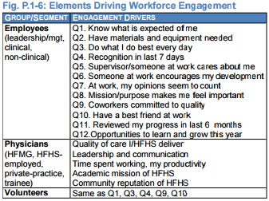

Slide 5
Assets and Regulatory Requirements
Henry Ford Health System’s Center for Simulation, Education, and Research, with computers and mannequins simulating hundreds of clinical scenarios, has enabled more than 12,000 participants to develop skills and try out new approaches in a risk-free environment.
Clinical information is linked across all our facilities through CarePlus Next Generation (CPNG).
Michigan is a Certificate of Need state; capital expenditures exceeding $2.9 million and changes in hospital beds and other specified clinical services require state approval.

Slide 6
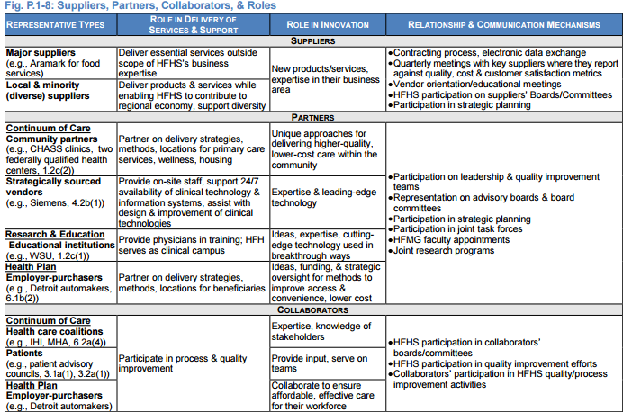
Organizational Structure, Customers and Stakeholders, and Suppliers and Partners
The PC is responsible for strategy development and implementation, organizational performance review (OPR), and oversight for HFHS’s performance improvement (PI).
To better understand and address their requirements, Henry Ford Health System involves patients and stakeholders in their design and improvement/innovation processes.
Their most important supply chain requirements are value, safety, availability/timeliness, reliability, and innovation. In addition, they are committed to supplier diversity.

Slide 7
Organizational Situation
Competitive Position. HFHS competes in many services across the continuum of care with large health systems and smaller, independent hospitals and health providers
Competitiveness Changes. The SEM economy, national health care reform, and the entrance of for-profit ownership are key competitive changes that create challenges and opportunities for HFHS. With our “can-do spirit”
Performance Improvement System. Through the Henry Ford Leadership System , leaders set the direction for performance excellence and model how to achieve it. They set visionary goals, with bold performance targets; communicate expectations and engage the workforce; monitor performance and analyze results to learn; recognize and reward high performance; and take action to drive improvement and spread best practices.

Slide 8
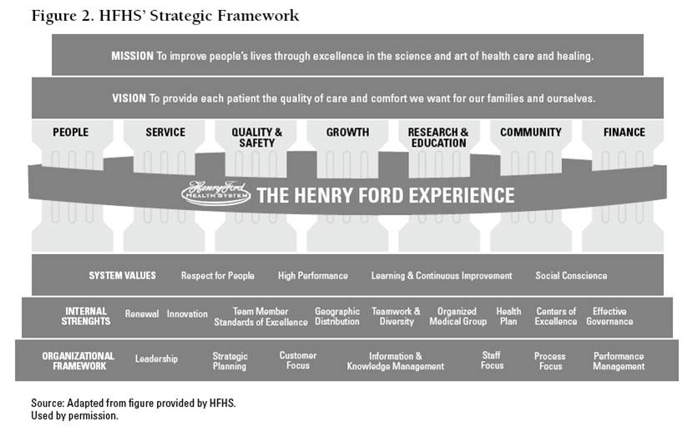
Use a 7-pillar framework (Fig. P.2-2) to organize and evaluate performance. The 7 pillars represent the areas most important to our success: People, Service, Quality & Safety, Growth, Research & Education, Community, and Finance. The framework aligns System SOs, SIs, and related performance measures and targets for the System and within BUs, from the top of the organization to the individual employee. System pillar teams evaluate and address progress within each pillar, while the PC sets priorities, evaluates progress, and coordinates improvement action across pillars Use a 7-pillar framework (Fig. P.2-2) to organize and evaluate performance. The 7 pillars represent the areas most important to our success: People, Service, Quality & Safety, Growth, Research & Education, Community, and Finance. The framework aligns System SOs, SIs, and related performance measures and targets for the System and within BUs, from the top of the organization to the individual employee. System pillar teams evaluate and address progress within each pillar, while the PC sets priorities, evaluates progress, and coordinates improvement action across pillars.

Slide 9
Reference
http://www.henryford.com/documents/Web/HFHS%20Application%20March%202012.pdf

