Slide 1
Applying the “Black Box Principle” to Pediatric Cardiac Surgery
Bowermaster, Rebecca, MS, Megan Miller, PA-C, Traci Ashcraft, PA-C, Michael Boyd, BS, Anoop Brar, PhD, Peter Manning, MD,FACS, and Pirooz Eghtesady, MD,PhD,FACS. "The American College of Surgeons." Journal of the American College of Surgeons 220.2 (2014): 149-55. Web. 8 Feb. 2015.

Slide 2
Introduction, or “What is the Black Box Principle?”
In aviation, the black box records everything that happens in the cockpit. In the event of an accident, or near-accident, this data can be reviewed afterwards to determine the causes.
This study applies the same principle to the operating room in what the authors called the “Intraoperative Improvement Initiative”, or I³.
Unlike previous studies, this study captures information on all failures, including ones other studies would have considered insignificant because they were inconsequential.
Also unlike previous studies, this study did not used trained observers to report failures, instead a nurse already on the surgical team was asked to record all failures in real time on a index card.

Slide 3
Methods
Before a procedure, an email would be sent to the surgeon describing the plan to record data.
On the day of surgery, email would be reviewed by the team before the surgeon scrubbed in.
When the operation was over, surgeon led a discussion about failure events throughout the operation
Failure Events were defined as anything that was unanticipated or unplanned beginning 1 hour before the operation to until the end of the operation.

Slide 4
Methods (Cont.)
As time moved forward, and operating teams grew more comfortable with the procedures of the study, the efficiency of collecting data improved.
A chart with failure event rates based on quarterly surgical volumes was used to track total failure event rates.
A pareto chart was used to display distribution of data among event categories.
Event category analyses were performed by using chi-square tests.

Slide 5
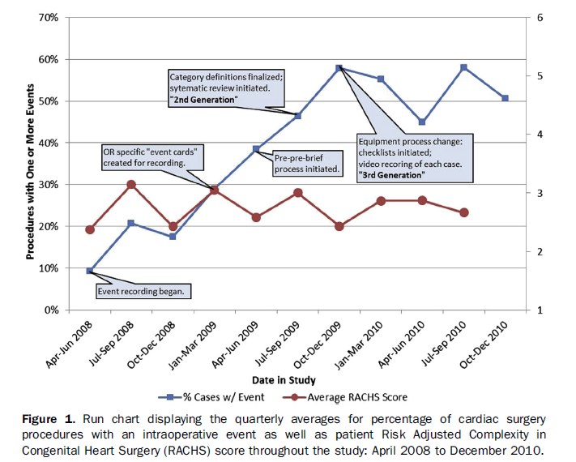

Slide 6
Results
951 cases performed from April 2008-December 2010
  619 open-heart
  322 closed heart
9 categories of events
  access
  blood
  change of plan
  communication
  equipment
  injury to patient
  medication
  patient instability
  other

Slide 7
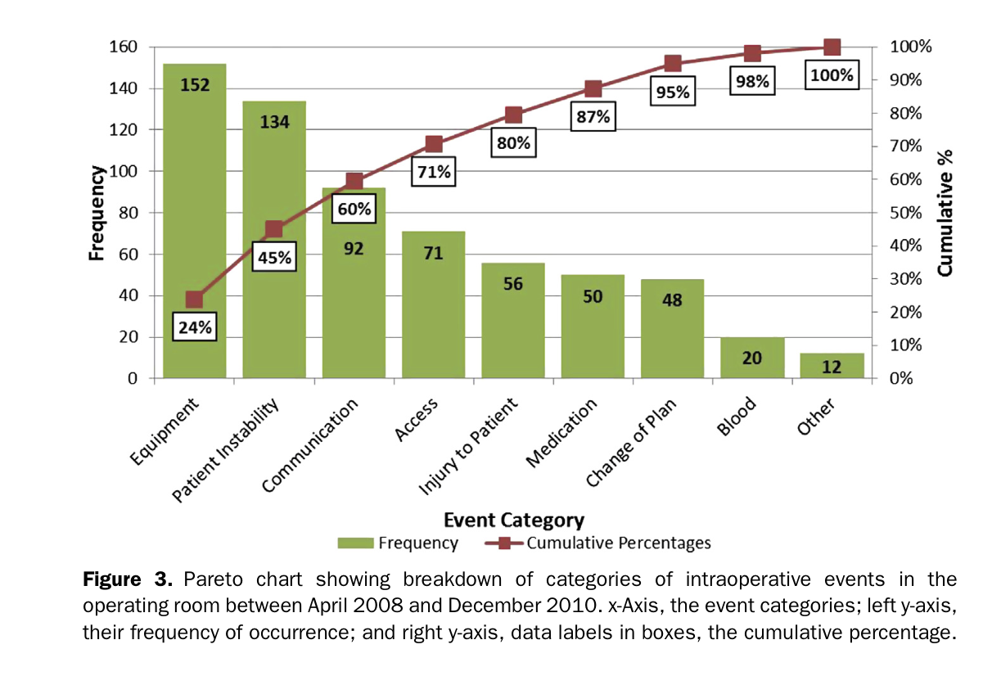

Slide 8
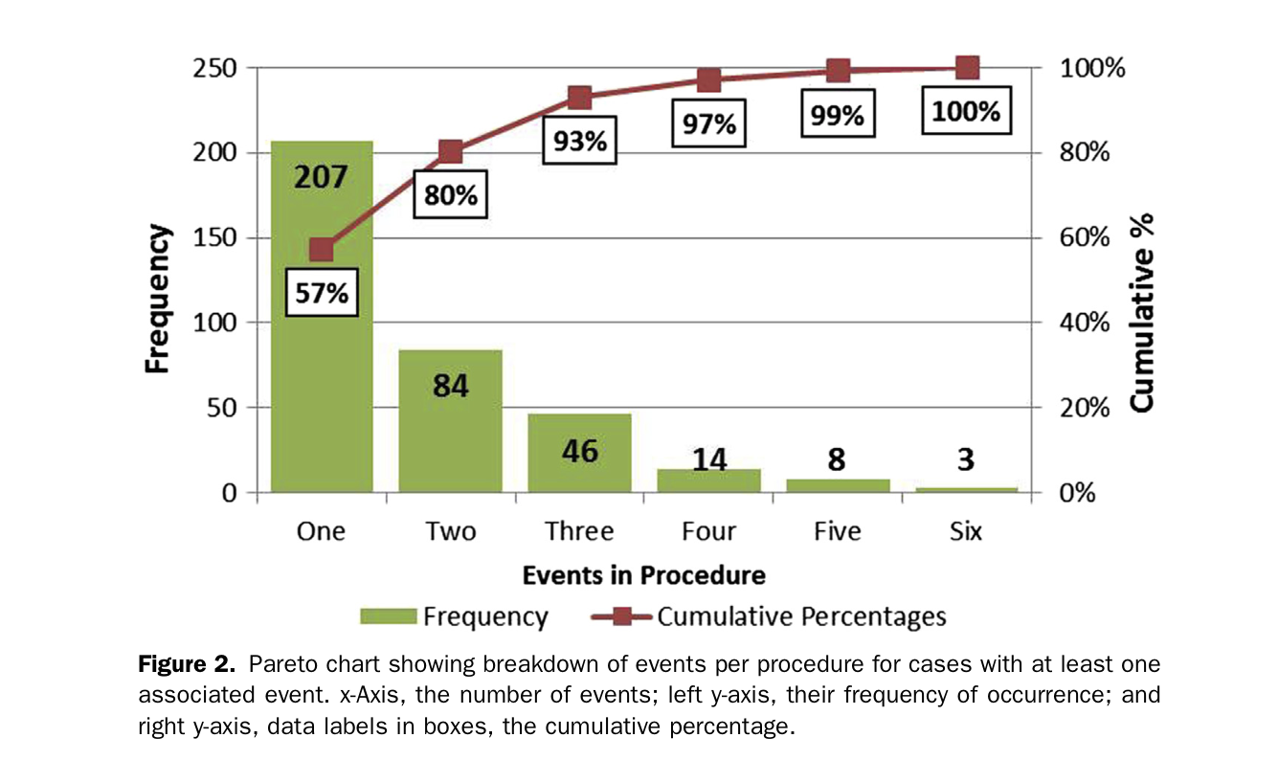

Slide 9
Results (cont.)
7.3% during closed-heart procedures
  communication
  patient instability
  equipment and access
Correlation between event types
  Patient instability, access, equipment, and injury to patient
  3 times more likes to happen in tandem in a procedure
Communication failures with circumstances that results in blood failures

Slide 10
Discussion
Implementation of systematic approach to recording events and failures yields an increase in event rate
  More data allows for a greater opportunity for more comprehensive analysis and insight on the issues
  Determine links between event categories
Most findings were expected, but there were many surprising results

Slide 11
Discussion (cont.)
Recurrent and predictable patterns of failures reflecting the OR “microenvironment”
  Initially unaware of these
Patterns of failures were similar for both open-heart and closed-heart procedures
  Equipment related more frequent with open-heart because of the use of extracorporeal circuitry
  High occurrence of equipment during closed heart surgery as well, but more likely from genesis of the system together

Slide 12
Discussion (cont.)
Communication with Risk Mgmt and Supply Chain Mgmt about transducer failures in isolated events
  Implement quality check
  Reduce dependence on a single manufacturer
  Detailed tracking information on failures; contact FDA
High association between events:
  Patient Instability and Injury to Patient
  Each 3x more likely if the other is present
  Increase anticipation and impact plan
Notes:
Replication of these studies should be adaptive to whatever microsystem is studied -- pediatric cardio is not the same as those failures expected in adult cardio
future studies are necessary to demonstrate the feasibility and relative importance to mitigating the events

Slide 13
Questions?
Thank you!

