Slide 1
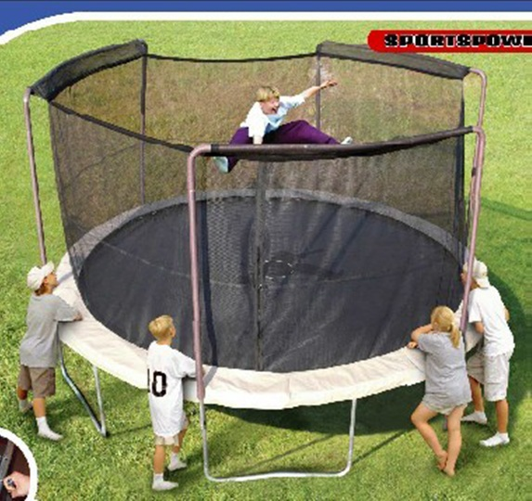
Product Recall
What: Sportspower BouncePro 14’ Trampolines
Recall Date: May 19, 2012 [1]
Why: The netting surrounding the trampoline can fail, posing a potential fall risk to those using the trampoline.
Incidents: Sportspower has received 17 reports of the netting breaking, 11 of which have resulted in broken bones, back/neck injuries, and contusions.
Number of Units Sold: 92,000 ($275) [1].
When Sold: February 2009 to February 2012

Slide 2
Reasons for Failure
According to Sportspower, the reason for failure of the product is attributed to the degradation of the netting material. Exposure to UV radiation and natural elements such as rain, wind, and heat, all play a role in compromising the integrity of the net. It is undoubtedly possible to use materials other than the tetlon used that will perform better under these conditions. A higher price to both the manufacturer and consumer is the most likely reason a material upgrade is not considered. Sportspowerw asserts that responsibility for ensuring proper function and condition of the netting is placed on the users of the trampoline.

Slide 3
Management Issues
Recognition of Problem: The trampolines in question have been for sale since February of 2012. About 92,000 of these units have been sold exclusively at Wal-Mart stores throughout the country. Sportspower has reported 17 incidents to the CSPC, 11 of which have resulted in a variety of injuries to the users, including broken bones and contusions. Since the May 2012 recall, Sportspower has expanded its recall (January 2013) to include an additional 28,000 units, reporting an additional 9 occurrences of the same problem with the netting [2]. No related issues with trampoline nettings have been observed in CSPC reported recalls, besides the Sportspower specific recall.
Speed of Response: The response to claims appears to have been fast. The 2012 recall was one of 4 found recalls of products in the trampoline category in the year [4].
Responsibility: No Sportspower statement to the public concerning the trampoline netting was found was found. However, Sportspower does seem to place some responsibility on the user of the trampoline, stating that the trampolines should be checked thoroughly before each use to ensure the safety of jumpers. The company offers a replacement net to any with sufficient proof of purchase [3].

Slide 4
Impact of Recall
Legal Consequences: As both of the recalls of the netting have been voluntary, the CSPC has not filed a lawsuit against Sportspower. Similarly, no information on any private lawsuits against Sportspower have been found.
Reputation: The incident seems to have no effect on the reputation of Wal-Mart or Sportspower. The recall was reported on the websites of many small news stations around the country, but the articles seemed more informational than accusatory. Furthermore, no comments or outcries from the public were found on any of these articles.
Sales: The 14’ Sportspower trampoline is no longer for sale at Wal-Mart locations. However, the brand does offer a 15’ trampoline for sale at Wal-Mart locations. There have been no recalls on this product.

Slide 5
References
[1] "Trampolines Recalled by Sportspower Limited Due to Fall Hazard; Sold Exclusively at Walmart." <i>United States Consumer Product Safety Comission</i>. 9 May 2012. Web. 28 Nov. 2014.http://www.cpsc.gov/ en/Recalls/2012/Trampolines-Recalled-by-Sportspower-Limited-Due-to-Fall- Hazard-Sold-Exclusively-at-Walmart.
[2] "Recall Bouncepro 14ft." Sportspower(TM). 24 Jan. 2013. Web. 28 Nov. 2014. <http://www.sportspowerltd.net/sportspower-care-recalls/recall- bouncepro-14-ft/>.
[3] "Sportspower Care." Sportspower(TM). Web. 28 Nov. 2014. http://www.sportspowerltd.net/sportspower-care-recalls/.
[4] "Recall: Sportspower Parkside Trampolines." WeMakeItSafer. 28 Nov. 2012. Web. 28 Nov. 2014. <http://wemakeitsafer.com/Sportspower-Parkside- Trampolines-Recall-194140-387266>.

