Slide 1
Lean Hospitals
Ch.8-Preventing Errors and Harm
By: David May

Slide 2
A Serious Problem
A study in 1999 by the Institute of Medicine said medical mistakes cause as many as 98,000 deaths a year in the United States
Data in a 2011 study in a journal Health Affairs showed that medical errors and adverse events occur in one of three admissions
In 2013, the Journal of Patient Safety published that 200,000-400,000 deaths occurred due to preventable harm in the USA
  This would make medical error the third leading cause of death in the USA

Slide 3
Other Terrifying Situations
Darrie Eason – a mislabeling in another patients specimen led to a misdiagnosing of cancer
  This caused an unnecessary mastectomy
  The other patient with cancer’s treatment was delayed
  The technician was blamed for cutting corners and fired
Dennis Quaid – His twin babies were given adult dosages of the blood thinner heparin by nurses
Josie King – An 18 month old girl died at John Hopkins after being given an additional dose of morphine by a visiting nurse

Slide 4
100% Inspection is not 100% Effective
Healthcare organizations tend to rely on inspection and double-checks
Adding extra inspections is not guaranteed to prevent surgical errors
When multiple people have the responsibility of inspecting for a defect humans can become complacent
Rhode Island Hospital:
  Rhode Island Hospital performed four wrong side brain surgeries in six years
  After an incident in July 2007, the hospital was ordered to add a second physician to review the proper site before surgery (another inspection)
  Another wrong-site surgery happened a month later

Slide 5
Being Careful is Not Enough
Inspections can also lead to passing the blame from managers to employees
Errors are often seen as a result of careless employees
Warning and caution signs all over a hospital are evidence of this attitude
Each sign is an indicator of something that has not been error proofed
Eric Cropp – a pharmacist in Ohio was convicted and jailed for a medication error killing a two-year-old girl
  He was blamed for not finding an error created upstream by a pharmacy technician who violated a standardized work practice

Slide 6
Error Proofing Introduction
Error Proofing - the creation of devices or methods that either prevent defects or inspect the outcomes of a process to determine if quality is acceptable or defective
Error Proofing Steps
  Make It Impossible to Create the Error
  Make It Harder to Create the Error
  Make It Obvious the Error Has Occurred
  Make the System Robust So It Tolerates the Error

Slide 7
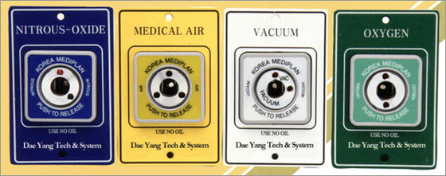
Make It Impossible to Create the Error
In an ideal situation error proofing would be 100% effective in preventing error from occurring
Examples:
  Diesel gas nozzles are made larger so they don’t fit inside an unleaded gas vehicle
  Regulators and gas lines have pins and indexing to prevent a user from connecting to the wrong line
http://techie-notebook.blogspot.com/2012/07/poka-yoke-applying-mistake-proofing-to.html

Slide 8
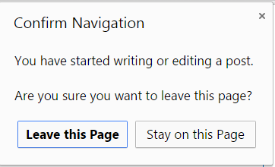
Make It Harder to Create the Error
It’s not always possible to fully error proof a process, so the next step is to make it harder for errors to occur.
Properly error proofing the entire process requires wider analysis and error-proofing methods at each step of the process.
Can be inexpensive and simple but should be designed so that complacency and overreliance doesn’t occur
Examples:
  A cabinet that opens up to a patients specific medication when a bar code is scanned
  Software that requires an active response, another inspection, to complete
https://superuser.com/questions/639084/malicious-confirm-navigation-dialogs

Slide 9
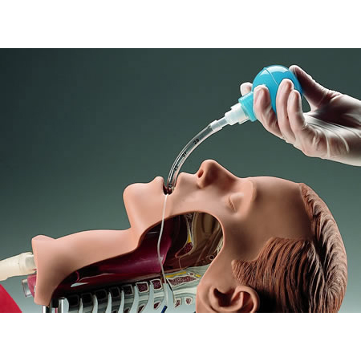
Make It Obvious the Error Has Occurred
Another error-proofing approach is to make it obvious when errors have occurred, through automated checks or simple inspection steps
Examples:
  Toyota weaving loom – when a thread broke the machine would stop preventing bad fabric from being produced
  Plastic aspiration bulbs to see if an intubation tube was placed correctly
https://www.buyemp.com/product/bulb-model-esophageal-intubation-detector-eid

Slide 10
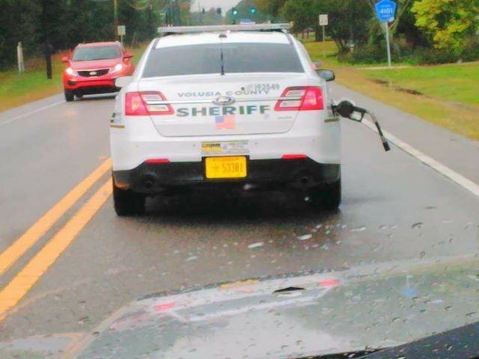
Make the System Robust So It Tolerates the Error
Designing products to be strong (robust) enough to handle foreseeable errors
Examples:
  Quick release valve that snaps away and cuts off the flow of gasoline if the driver leaves the pump nozzle in their car
  Test instruments that can withstand spills
https://www.youtube.com/watch?v=wSGTlAuf9qg

Slide 11
Error Proofing, Not Dummy Proofing
“Poka yoke”- Error proofing Japanese equivalent term
  This phrase focuses on the error itself instead of the person who made it
Error proofing can sometimes be used interchangeably with “idiot proofing” and “dummy proofing”
This does not demonstrate respect for people
Not all mistakes are caused by judgment or ignorance
Humans are prone to errors and mistakes so the system needs to be error proofed accordingly

Slide 12
Error Proofing the Error Proofing
Error Proofing methods should not be easy to circumvent and if people are trying to get past the methods you should understand why.
Ask questions like when the original error proofing was created
Questions:
  How can we prevent the circumvention of the error proofing?
  Why do people feel the need to circumvent error proofing?
  How can we make it harder to circumvent the error proofing?
  How can we make it obvious or apparent that the error proofing has been circumvented?

Slide 13
Lean Lessons (p.195)
Being careful and hanging warning signs is not enough to prevent errors.
A 100% inspection is not 100% effective.
Adding more inspection steps will not ensure quality outcomes.
Error proofing (poka yoke) physically prevents errors from occurring or makes them least likely to occur.
Avoid phrases like “dummy proofing” to keep with the principle of respect for people.
Do not forget to error proof the error proofing.

