Slide 1
Lean Hospitals:
Improving Quality, Patient Safety, and Employee Engagement
Ch. 6 Lean Methods: Visual Management, 5S, and Kanban
Presented by Caroline Merz
ETM 528
Monday, April 16th 2018

Slide 2
Introduction
“Many organizations have old habits of ignoring, hiding, or covering up problems” (Lean Hospitals, pg 121)
This results in “information deficits” that cause misunderstandings and waste of time and money
The lean methods discussed in this chapter include:
Visual Management
5S method
Kanban method
These methods seek to reduce workplace waste (time, money, energy expenditure) and improve workplace understanding and organization

Slide 3
Visual Management
Mindset: How can we make the process more visual and problems more apparent?
Goal:
Make problems or status visible
Manage the situations, reacting as needed for the short term as well as solving root causes of the problems for the long term
If successful: reduces workplace stress, improves patient care, reduces time and money waste

Slide 4
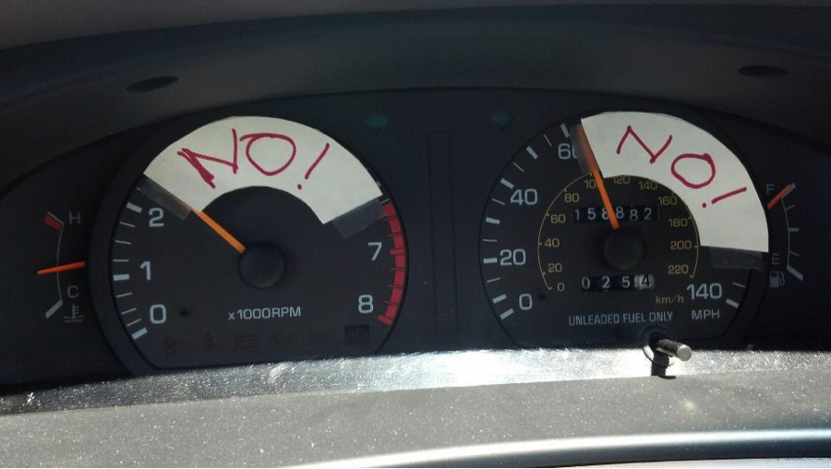

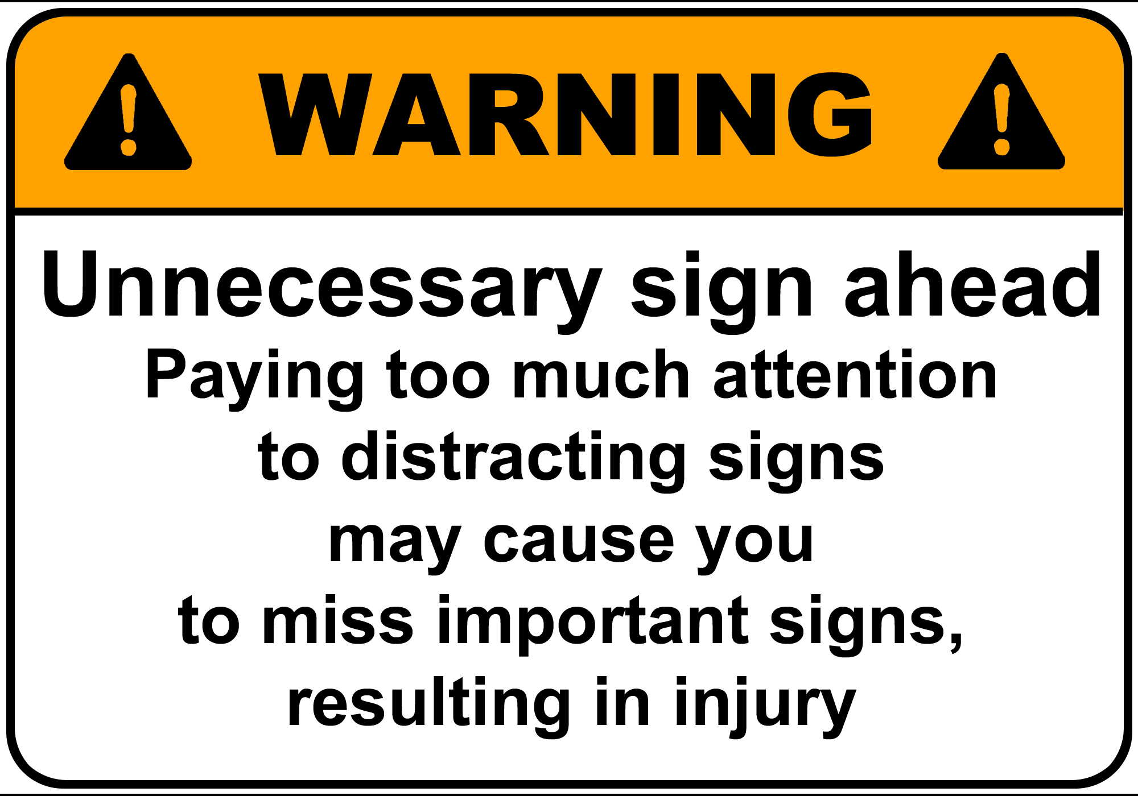
Examples of Visual Management
Is: Differently colored flags outside patients’ door to indicate the status of the patient
Is not: Performance measures
or warning signs
from “Visual Management in your Car” (2012), Christian Paulson, retrieved from https://christianpaulsen62.wordpress.com/2012/01/03/5-visual-management/
from “Control The Last Planner System Using Visual Management” (2016), Algan Tezel; retrieved from http://leanconstructionblog.com/Control-The-Last-Planner-System-Using-Visual-Management.html
retrieved from http://sf.co.ua/id140897

Slide 5
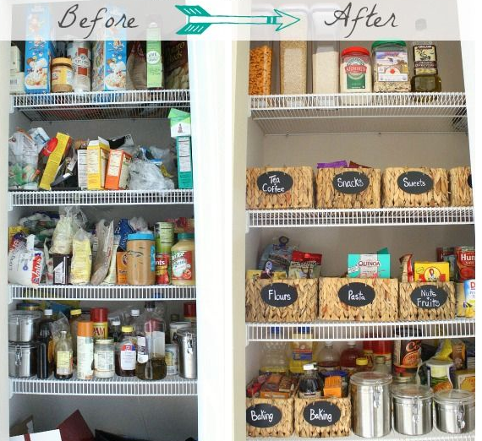
5S Method
What is it?
Method of waste reduction through improved workplace organization and visual management
Five phases:
Sort
Store
Shine
Standardize
Sustain
Retrieved from http://designdininganddiapers.com/2013/01/new-pantry-organization/

Slide 6
First S: Sort
What is it?
Sorting through and getting rid of materials that are no longer needed
Ex: expired reagents, broken computers/keyboards
Why is it necessary?
Unneeded items take up space, making a department larger than it needs to be and increases construction and maintenance costs
Questionable items that might be needed?
→ Solution: Buffer zone/5S sort area
Items stored for a week to allow everyone to review the items to be thrown away
Prevents rash decision-making and waste of disposing items that would need to be repurchased

Slide 7
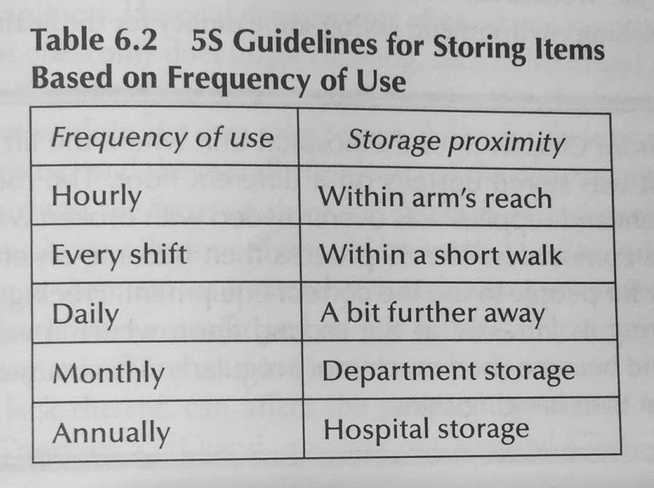
Second S: Store
What is it?
Storing items most frequently used closest to their point of use
Why is it necessary?
Reduces waste of employee motion and time
Materials used in multiple areas/departments?
→ Solution: Multiple storage points if the materials are inexpensive and take up little space. Ex: latex gloves
from Lean Hospitals (2016), Mark Graban, pg 127

Slide 8
Third S: Shine
What is it?
People who work in a department take responsibility for keeping their area clean (aside from major cleaning done by centralized housekeeping)
Why is it necessary?
Cleanliness affects patients’ experience and perception of a hospital
Helps keep area safe and allows for easier detection of environmental/equipment problems

Slide 9
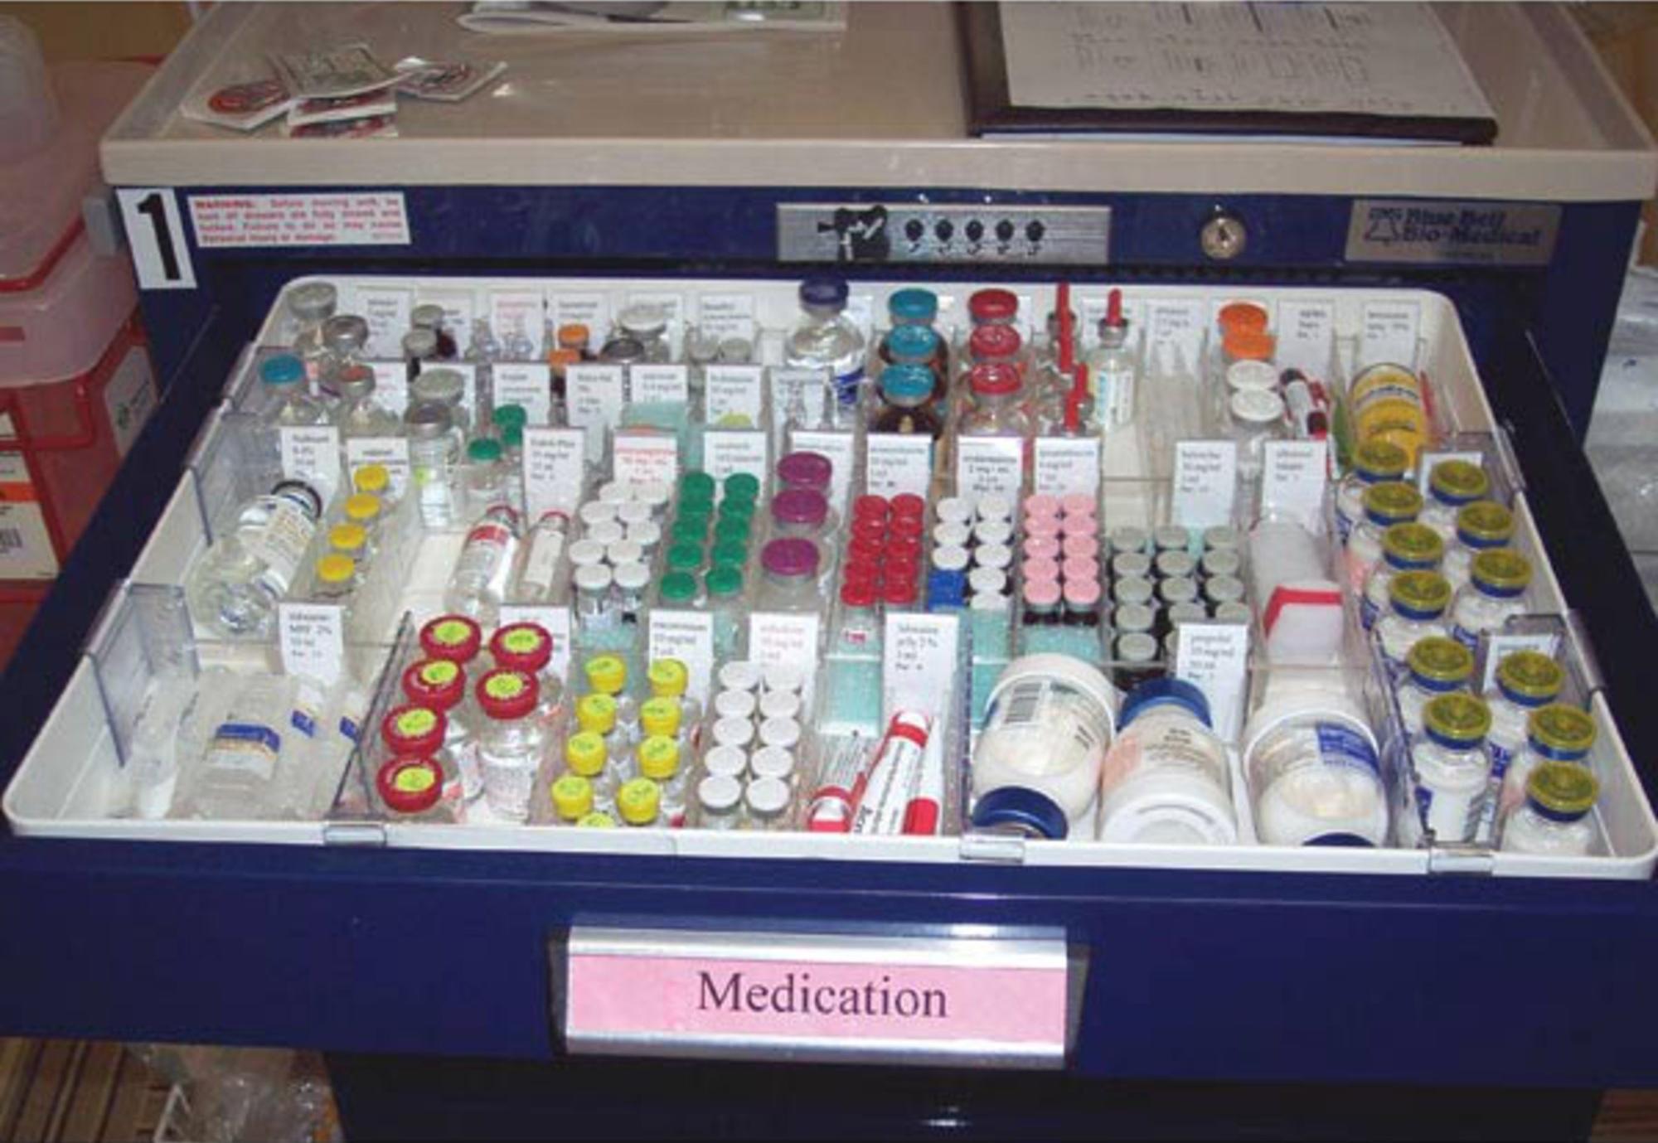
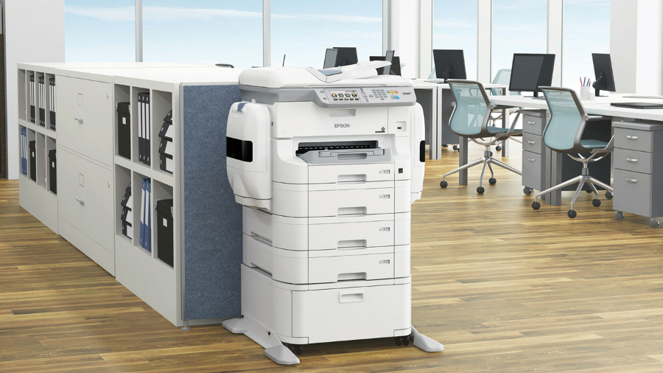
Fourth S: Standardize
What is it?
Ensuring that items are always kept in defined locations
Why is it necessary?
Reduces time wasted looking for items
**Standardize things that matter**
Ex: Printer vs medication cart drawer
retrieved from http://www.newmaticmedical.com/carts/p/MedicationDrawerTrays/
retrieved from https://www.techradar.com/how-to/computing-components/printers- and-scanners/how-to-choose-an-office-printer-1301630

Slide 10
Fifth S: Sustain
What is it?
A plan for sustaining and continually improving workplace organization
Ex: scheduled audits so supervisors/leaders can ensure standards are being followed
Why is it necessary?
To prevent S5 organization from being a one-time event or a repeated annual event

Slide 11
Kanban
kanban = “signal,” “card,” or “sign”
What is it?
A method of managing materials through the use of physical signals, paper cards, or plastic bins that indicate when it is time to order more, from whom, and in what quantity
Con: Can require significant time investment initially
Pro: Prevents both stock-outs and over-ordering; Saves time, effort, and money in the long-term

Slide 12
Problems with Traditional Materials Systems
Standing Orders
Vendors send a predetermined amount of materials each period (weekly, monthly, quarterly)
Pro: Materials arrive automatically
Con: Does not adapt to changes in material usage
Par Levels
Items are replenished only in the quantities in which they are being used
Pro: Advance over standing orders
Con: Each individual item must be counted every time restocking occurs
Electronic Inventory Cabinets
Staff members press a button each time they remove an item from the supply cabinet
Pro: Easier restocking
Con: Forgetting to press the button or the button not properly registering causes the inventory count to be higher than what it actually is; and only one person can use the cabinet at a time

Slide 13
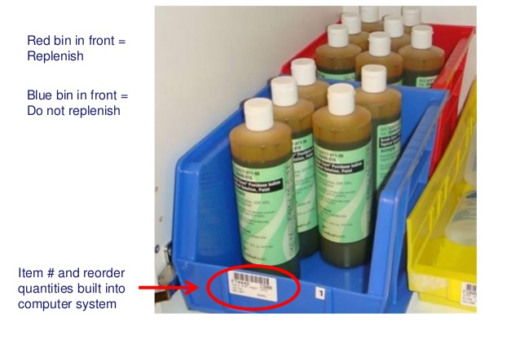
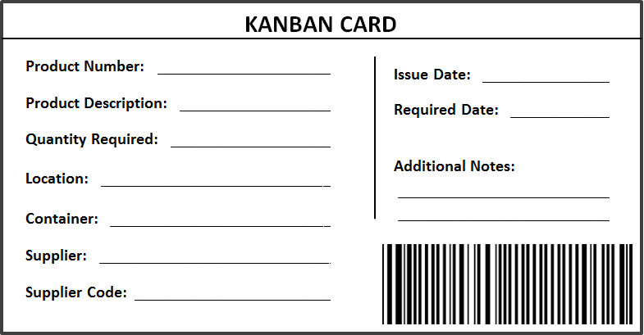
Using Kanban to Replenish Supplies
Kanban cards
Card is placed with supply
Should include info such as when to reorder, reorder quantity, and supplier information
Two bin system
Visual way of managing inventory
When one bin is empty, it is time to order more
Retrieved from http://www.leantoolset.com/kanban/
Retrieved from https://www.slideshare.net/KarenMartinGroup/kanban-overview2/
14-TwoBin_System_BarCoded_No_CardRed

Slide 14
Lean Lessons (page 147)
Visual management helps expose problems and avoid miscommunications and waste.
5S reduces waste through improved organization and visual methods.
5S is not a one-time event - it is a plan to be sustained to maintain and improve workplace organization.
Supplies and items that are used most frequently should be kept closest to the point of use
Hiding the mess behind cabinet doors does not fix the root cause of the disorganization problem.

Slide 15
Lean Lessons cont’d (pg 147)
Kanban can be implemented using cards, plastic bins, or electronic signals.
Kanban requires much less counting and time than par levels.
With materials, we need to view trade-offs between the cost of inventory and the cost of running out. Hospitals might need to err on the side of not running out.
When we have more variation in the system, we need more safety stock to protect us.

Slide 16
References
Graban, M. (2016). Lean hospitals: Improving quality, patient safety, and employee engagement(3rd ed.). Boca Raton: Taylor & Francis.

