Slide 1
Drew Elrod
BS IDM Graduate
Interviewed by Student Name
date

Slide 2
Interviewee Name and Current Employment
Mr. Drew Elrod, MBA, CHFM
Innovation Engineer, Medical Center, Navicent Health

Slide 3
Employment History
While in school
Upon graduation
Career path since

Slide 4
Education and Certifications
BS Industrial Management Mercer University 2007
MBA 2009
CHFM (explain)

Slide 5
Is the medical field an undiscovered market for IDM graduates?
Invaluable skillset which allows removed view of problems in order to bring working solutions to bear.
Affordable Care Act will have hospital administrators scrambling to maintain financial internal balance which an IDM major is well equipped to do.
Needed to maintain profitability as reimbursement goes down and the payment structure changes.

Slide 6
Typical day or other interesting questions…
I typically work ____ hours a week
I attend meetings every day
I travel less than _ weeks a year.
ETC.

Slide 7
Additional Comments
  “I love being able to take on problems from departments all over the hospital and translate them into working solutions.
  I think it is fun that I get to think about problems in new and different ways from people in other departments.
  As a result, I am able to offer perspective and solutions that they often cannot see.” –Drew Elrod

Slide 8
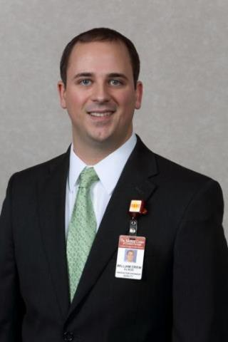
Interviewer email (optional)
Interviewee email (optional)
Interviewee photo (optional)

