Slide 1
The Relationship Between Emergency Department Crowding and Patient Outcomes: A Systematic Review
Monique Demers

Slide 2
Citation
Carter, Eileen J., Stephanie M. Pouch, and Elaine L. Larson. "The Relationship Between Emergency Department Crowding and Patient Outcomes: A Systematic Review." Journal of Nursing Scholarship: 106-15.

Slide 3
Overview
Purpose
Methods
Results
Discussion
Conclusion

Slide 4
Purpose
The goal of the study was to determine the relationship between crowded emergency departments (ED) and patient outcomes.
  Overcrowding is a safety concern
  Overcrowded ED’s can lead to lower quality care

Slide 5
Overview
Purpose
Methods
Results
Discussion
Conclusion

Slide 6
Methods
Study Selection
  Abstracts and titles were screened for relevance
  Studies pertaining directly to ED capacity, length of stay, etc. were given consideration
  11 studies total were selected for review
Study Exclusion
  Interventions to alleviate crowding
  Care processes associated with crowding
  Tools to forecast or measure crowding
  Other resources that were not peer-reviewed articles in English

Slide 7
Methods-Data Extraction
A tool was developed for data extraction which included the following fields
  “Primary author of the study and year of publication, study design, inclusion criteria and population studied, ED type…,measure used to quantify crowding, measure used to quantify patient outcome, study results, and study limitations” (Methods-Data Extraction)

Slide 8
Methods-Quality Assessment
Domains were created, i.e. whether a question was properly formed, the population being studied, etc.
Quality of the selected studies were determined by comparing the study to the domains.
Disagreements were resolved through discussion

Slide 9
Overview
Purpose
Methods
Results
Discussion
Conclusion

Slide 10
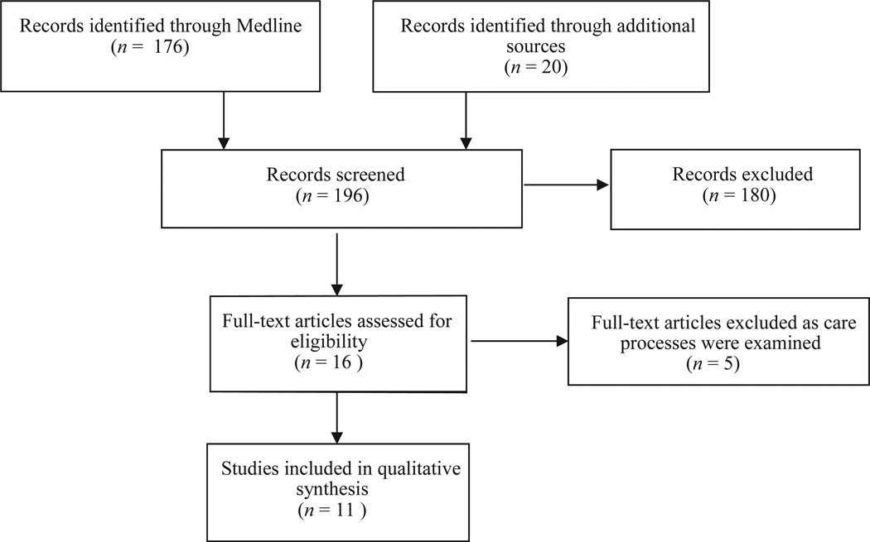
Results
11 studies selected for review, from the original 196
Results, Figure 1

Slide 11
Results-ED Characteristics
ED’s reviewed were in urban areas
Generally studies were of ED’s with annual visit rates over 45000
Only three were conducted outside of the US

Slide 12
Results-Relationship
The majority of the reviewed studies examined
  Waiting room time
  Waiting room census
  ED occupancy
The relationship between ED crowding and patient care outcomes is significant

Slide 13
Overview
Purpose
Methods
Results
Discussion
Conclusion

Slide 14
Discussion
Of the 11 studies examined, only 4 discussed patient health, most of the studies were process oriented
Methodology varied across the studies
The Affordable Care Act has given health coverage to an additional 30 million Americans. A study of the impact of the Affordable Care Act and ED crowding should be conducted

Slide 15
Overview
Purpose
Methods
Results
Discussion
Conclusion

Slide 16
Conclusion
ED crowding is linked to
  “Higher rates of inpatient mortality among those admitted to the hospital from the ED and discharged from the ED to home”
  Higher rates of patients leaving the ED before care was given
  The relationship between ED crowding and patient care is significant and policies must be examined for the safety and care of the patients

Slide 17
Questions?

