Slide 1
Control Chart Examples Using Minitab 17
Dr. Joan Burtner
Associate Professor and Chair
Department of Industrial Engineering and Industrial Management
Spring 2018

Slide 2
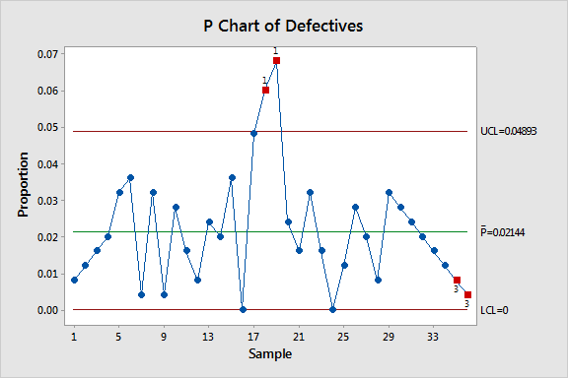
P Chart (percent defective)
A constant sample size of 250 units was used for this chart. Note that the UCL is constant for all 35 samples.

Slide 3
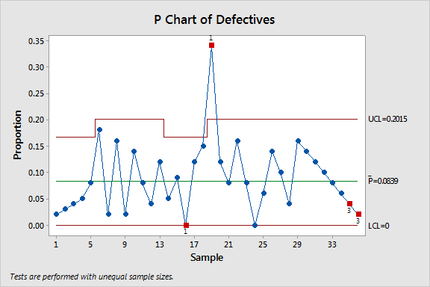
P Chart (percent defective sample size varies)

Slide 4
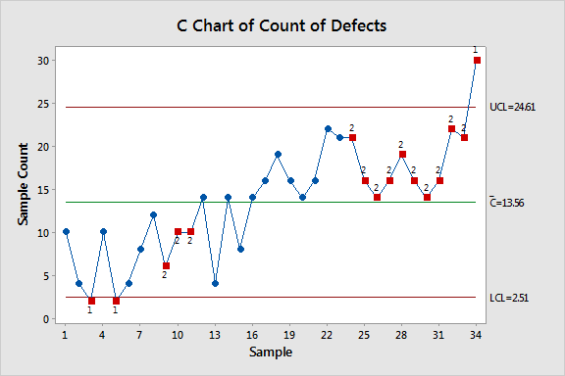
C Chart (number of defects)

Slide 5
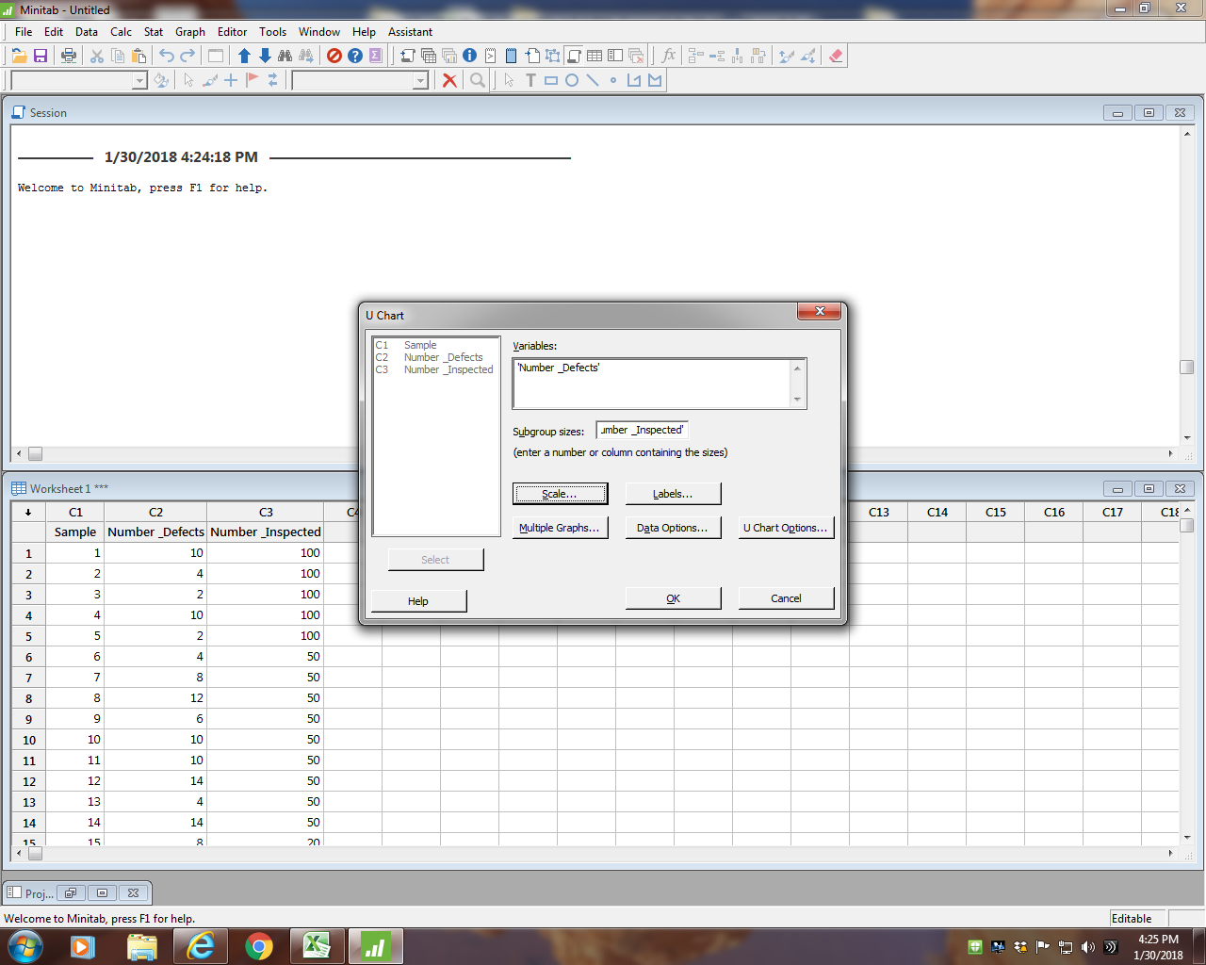
Minitab Dialog Box

Slide 6
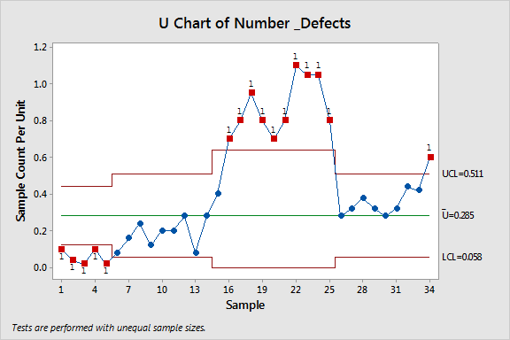
U Chart with only one special cause test selected

Slide 7
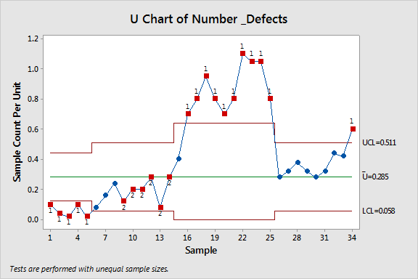
U Chart with tests for all special causes selected

