Slide 1
Clarifying "never events" and introducing "always events"
Editorial Open Access
Clarifying "never events" and introducing "always events"
Alan Lembitz* and Ted J Clarke
Patient Safety in Surgery 2009, 3:26 doi:10.1186/1754-9493-3-26
Presentation by Students Enrolled in ISE 468 Spring 2015

Slide 2
Editorial
Further confusion persists about the definition of "never events" as they relate to either "serious reportable events" by the NQF, in contrast to conditions defined by the Centers for Medicare and Medicaid Services (CMS) have deemed as "non-reimbursable serious hospital-acquired conditions".

Slide 3
National Quality Forum (NQF)
Nonprofit organization that aims to improve the quality of healthcare in the United States;
The NQF defined a total of 28 "never events“ or known as "serious reportable events“ that can be found at http://www.pssjournal.com/content/3/1/26/table/T1
These encompass serious adverse events occurring in hospitals that are largely preventable and of concern to both the public and to healthcare providers;
Not all NQF events are preventable at all times or indicative of obvious negligence;

Slide 4
Center for Medicare and Medicaid Services (CMS)
An agency within the US Department of Health & Human Services responsible for administration of several key federal health care programs;
"never events" is defined as "non-reimbursable serious hospital-acquired conditions" - in order to motivate hospitals to accelerate improvement of patient safety by implementation of standardized protocols;
Applied only to those events deemed "reasonably preventable“;
"The new payment approach is actually a relatively small step in a cautious, intermittent, 50-year effort by payers to stimulate U.S. hospitals and clinicians to accelerate improvement in the quality of care and reductions of wasted spending". – Milstein, Arnold

Slide 5
Liability concerns and negligence claims
The biggest concern is the public confusion between the two distinct definitions by the NQF and CMS;
Some of the events on the NQF "never events" likely carry liability. While the amount of compensation may be questionable, few argue against the just compensation for injuries that result from never events;
Many of the non-reimbursable CMS "never events" are not completely preventable, even with the best practice of evidence-based treatment. Some are concerned that they will be told that those "never events" are based on negligence or medical errors;

Slide 6
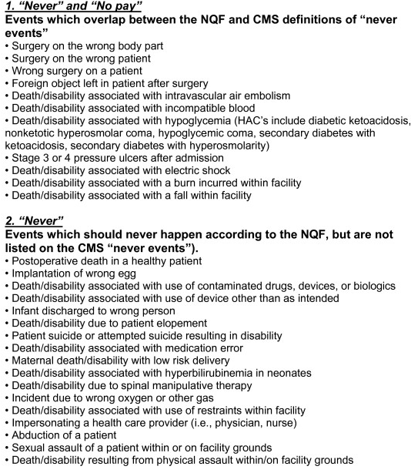
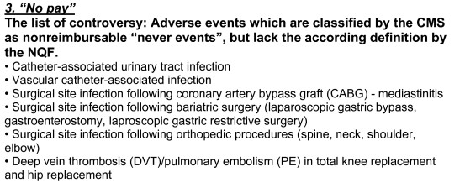
Comparison of “never events” – NQF vs CMS

Slide 7
Some examples related to the controversy related to the preventability of some of the listed conditions are prevention of falls and postoperative infections and thromboembolic events;
Prevention of falls
A recent editorial in the New England Journal of Medicine argues that the inclusion of "falls" on both lists is misguided;
According to the editorial, "Falls are often the result not of medical errors but of disease, impairments, and appropriate uses of medications and other treatments. Falls and injuries can occur even when hospitals provide the best possible care"
Postoperative infections and thromboembolic events
It is known that certain orthopaedic procedures can result in the hospital-acquired conditions of postoperative infections and thromboembolic events. Neither complication can ever be completely prevented.
There is a need to officially clarify that falls, postoperative infections, and thromboembolic events are "non-reimbursable serious hospital-acquired conditions", but not "never events"

Slide 8
Strategies to reduce risk
• Pretreatment or pre-hospital documentation of underlying pre-existing conditions, particularly those involving infections, pressure sores, altered mental status, hyper-/hypoglycemia, and patients at high risk for venous thromboembolism;
• Standardized and universally followed approaches to reduce wrong site/wrong patient surgery;
• The use of surgical checklists;
• Culture-changing training around communication, assertiveness, team training, and the use of briefings and debriefings, particularly in high-acuity patient care areas.

Slide 9
Introducing a positive approach towards a patient safety: “ the always events”
The concept of the "always events" represents a positive affirming behavior that can motivate us to improve patient safety and promote better outcomes. Some examples are:
Including patient identification by more than one source;
Disclosure of adverse outcomes and transparency with patients and families;
Surgical time-out;
Medication error reduction strategies;
Tracking of critical imaging, lab and pathology results;

