Slide 1
Lockheed-Martin: Leadership
Brady Bradshaw, Daniel Souza, Trey Hartman

Slide 2
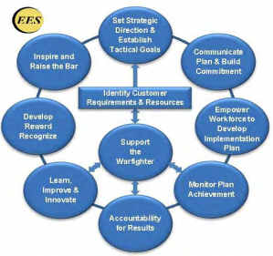
1.1a - Vision and Values
Vision: “To be the most respected global leader in every market and community we serve through the pride, commitment and power of people.”
Values: “Do What’s Right, Respect Others and Perform with Excellence.”
Training is performed in a top-down approach every year, following a BCG (Business Conduct Guideline).
All suppliers participate on the process of improvement and abide with all company’s Values and Vision.
MFC conducts annual ethics training for the entire company, starting with the President.
MFC has a Zero Tolerance Policy for unethical and illegal behavior, and created an Office of Ethics and Business Conduct.
Sustainability is taken in consideration whenever decisions are made, alongside with growth and profitability.
MFC Performance-Driven Leadership System - Developed in 1999 and reviewed every year.
Bradshaw, Souza, Hartman 2/10/16 2

Slide 3
1.1b-Communication and Organizational Performance
Communication:
  Use digital, print, interactive and face-to-face techniques to facilitate consistent messaging inside and outside the company
  Engage employees, encourage frank, two-way communication and take an active role in reward and recognition programs that reinforce high performance and a customer and business focus
  Continually assess new communication technology to improve the business.
Focus on action:
  Every individual and team throughout the Enterprise has goals and metrics that align to the Strategic Plan, and they know exactly what must be accomplished to achieve MFC’s and customers’ objectives, requirements, goals and budgets.
Bradshaw, Souza, Hartman 2/10/16 3

Slide 4
1.2a-Organizational Governance
Governance system:
  Ensures ethical business practices and accountability, above and beyond compliance with laws, regulations and policies
  Accountability for Management’s actions
  Fiscal Accountability
  Transparency in Operations
Performance evaluation
  The achievement of predefined commitments on objectives, goals and metrics related to individual accomplishments and Enterprise performance provides basis for evaluation
  In senior positions, a percentage of salary is held back until the end of the year when it can be determined by achievement of performance objectives, goals and metrics
Bradshaw, Souza, Hartman 2/10/16 4

Slide 5
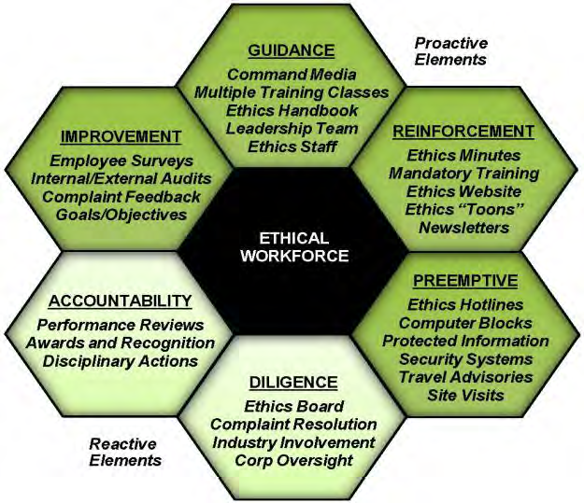
Legal and Ethical Behavior
Many products include explosives, lasers, and radioactive and corrosive materials
  Clients are warfighters in the field, so unsafe products are not an option.
  Strictly adhere to OSHA and other safety guidelines, reduce carbon footprint, proactively mitigate risk of harm.
  Risk Opportunity Management Plan (ROMP) throughout Enterprise to manage risk and opportunities.
Ethical behavior is expected of all employees and
ethicality is evaluated in all performance evaluations
  Everyone is ecouraged to contact Ethics Department or
or hotline about unethical behavior
  Disciplinary Review Board examines significant findings
and Ethics organization monitors trends and uses them for
targeted training and communication with employees
  any third parties are affected, contact and remedial action
are made immediately

Slide 6
Societal Responsibilities and Support of Key Communities
Leadership focuses MFC on being a good corporate citizen.
  MFC is often largest employer in the area where it’s located, so it supports all local functions such as school outreach programs, internships, and Career Days.
  Works with suppliers and communities to establish “Green” initiatives such as ordering recycled office supplies and reducing packaging.
All senior leaders play a key role in community support.
  Executives sponsor and encourage employees to participate in charitable organizations and events in the communities where they live.
  MFC even has a program set up where employees can enter volunteer hours and receive awards and recognition for their volunteerism.
  Charities that they work with include Wounded Warrior Foundation, Army Relief Fund, United Way, and many others.
Bradshaw, Souza, Hartman 2/10/16 6

