Slide 1
IDM Alumni Snapshots ISE Alumni Snapshots
Compiled by Dr. Joan Burtner
Chair, Department of Industrial Engineering and Industrial Management
2017

Slide 2
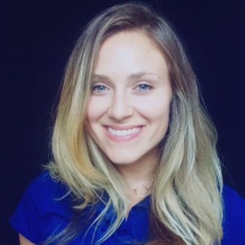
Jamie Duffy Process Improvement Engineer University Health Care System Augusta, GA
BSE 2013
Mercer University School of Engineering
Industrial Engineering
MSE 2014
Engineering Management
Mercer University School of Engineering
Master’s Thesis: Anthropometry of Lower Limbs in the Mekong River Delta Region of Vietnam and its Implications for Fitting Prosthetics (Dr. Laura Moody, Thesis Advisor)
Career Path
Systems Redesign Intern, VA Long Beach Health Care System, Long Beach, CA. 2014
Packaging Design Intern, Spectrum Brands, Middleton, WI. 2014-2015
777 Occupational Health and Safety Specialist, Boeing, Everett, WA. Feb 2015 to Aug 2016
Process Improvement Engineer, University Health Care System, Augusta, GA. 2016 to present

Slide 3
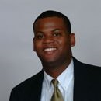
Dericus Harvey Business Consultant Chick - fil - A Atlanta , Georgia
BSE 1999
Mercer University School of Engineering
Industrial Engineering
Chief Justice, Mercer Judicial System
MBA Finance 2004
Indiana University – Kelley School of Business
Automotive Industry
General Motors (Production Supervisor 1999-2000)
Ford Motor Company (Manufacturing Engineer 2000-2002)
Johnson & Johnson
Senior Brand Analyst – Commercial Finance 2004-2005
Senior Financial Analyst - WW Supply Chain 2005-2007
Finance Manager – WW Business Development 2007-2008
Manager – Domestic Treasury 2008-2011
Chick-fil-A
Business Consultant, February 2011 to present
Source: LinkedIn Oct 2016

Slide 4
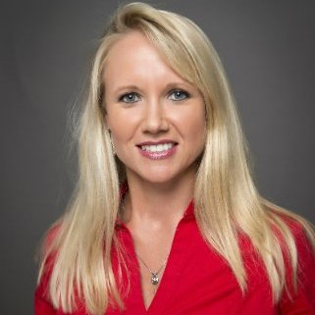
Kasie Jenkins Sr. Manager, Final Phase Operations Gulfstream Aerospace Long Beach, CA
BS 2004
Mercer Univ. School of Engineering
Industrial Management major
MBA 2006
Georgia Southern University GPA 4.0
Certifications
Lean Six Sigma Green Belt
Certified Project Manager
Career Path at Gulfstream (Savannah)
Industrial Engineer 2003-2006
Initial Phase Operations Manager 2006-2010
Final Phase Operations Manager 2010-2013
Career Path at Gulfstream (California)
Senior Manager, Final Phase Operations 2013 to present

Slide 5
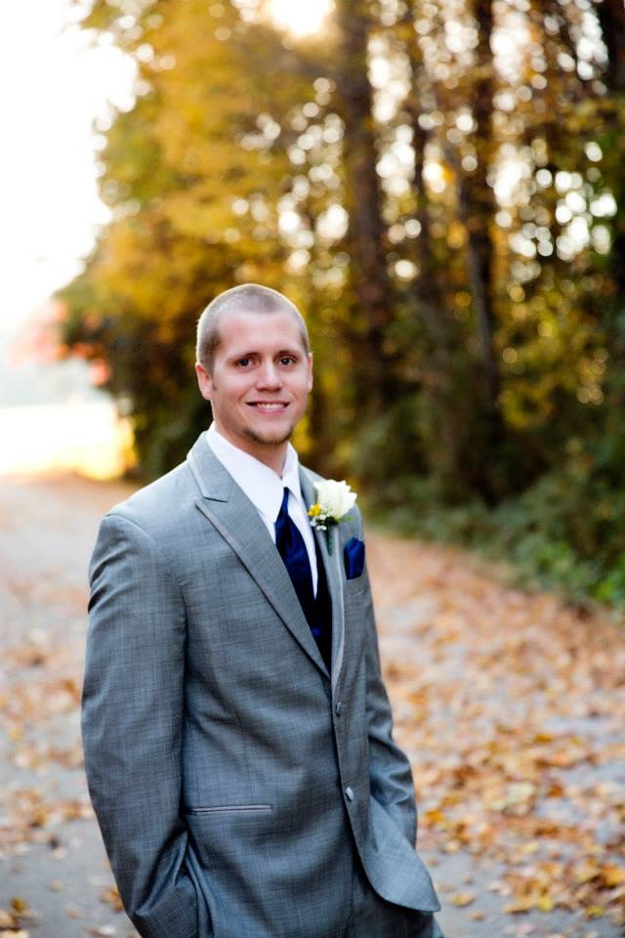
Russell Hazelrig Reliability Engineer II Baxter International, Inc. Covington, GA
BSE 2011
Mercer Univ. School of Engineering
Industrial Engineering
Business Administration minor
Certifications
Six Sigma Green Belt
Six Sigma Black Belt
Certified Quality Engineer (Automotive Industry)
Certified Project Manager
Career Path
SRG Global (Automotive)
Industrial Engineer
Quality Engineer
Baxter (Healthcare)
Reliability Engineer II

Slide 6
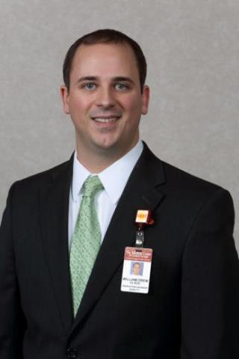
Drew Elrod Chief of Staff The Medical Center, Navicent Health Macon, GA
BS 2007
Mercer Univ. School of Engineering
Industrial Management Major
MBA 2009
Mercer University
Certifications
CHFM, Certified Six Sigma Black Belt
Career Path at The Medical Center, Navicent Health (formerly The Medical Center of Central Georgia - MCCG)
Hired as a co-op at MCCG during college
Completed Senior Design project at MCCG
Hired full-time in 2007 with the title Industrial Engineer
Promoted to Innovation Engineer(2015)
Promoted to Chief of Staff (2016)

Slide 7
Drew Elrod Innovation Engineer The Medical Center, Navicent Health Macon, GA
“Change in healthcare is happening at warp speed. Healthcare organizations must continuously reengineer the way they operate to remain competitive or risk becoming irrelevant. As the market consolidates, successful healthcare organizations are turning to engineers and those with an entrepreneurial spirit to redefine the service delivery model. Concepts such as simplification, fast work, process optimization and big data are integral to the healthcare value equation. Engineers are uniquely qualified to address the challenges facing the healthcare delivery system, and I believe you will see an employment surge for healthcare engineers in the future.”
(Dr. Joan Burtner, personal communication, March 2, 2015)

Slide 8
Drew Elrod Innovation Engineer The Medical Center, Navicent Health Macon, GA
“I love being able to take on problems from departments all over the hospital and translate them into working solutions. I think it is fun that I get to think about problems in new and different ways from people in other departments. As a result, I am able to offer perspective and solutions that they often cannot see.”
(Personal Communication with IDM student Whitney Boyer 2009)

Slide 9
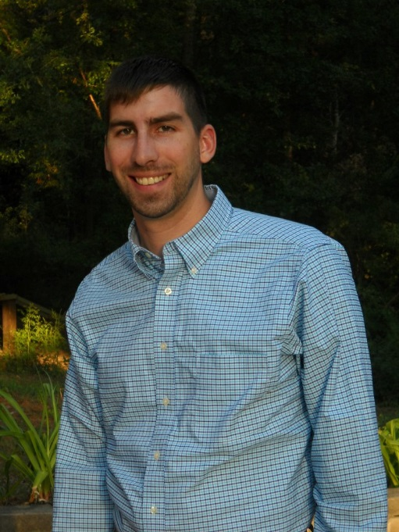
Ned F. Nobles Project Management ESG Operations, Inc. Warner Robins, GA
BS MUSE 2014
Industrial Management
“I was hired for a 3 month part time CAD job at ESG Operations over the summer and was asked to stay on full time 3 weeks later. ESG is an environmental engineering firm and utilities contractor that specializes in water and waste water but covers much more. I work mostly at the corporate office making construction plans and drawings in CAD or writing applications for permits. When I get a chance, I spend time in Warner Robins learning waste water and project management at the Sandy Run waste water plant. Besides a basic understanding of CAD and the Project Management class I attended at Mercer, what I do on a daily basis is new to me and was not part of my formal degree. My time at Mercer taught me to research, learn, and apply so that I can solve problems and make improvements regardless of the working environment.” (Dr. Joan Burtner, personal communication, Nov. 19, 2014)

Slide 10
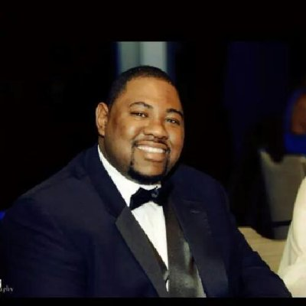
Morge Miller Supplier Quality Engineer The Coca Cola Company Atlanta, GA
BSE 2004
Mercer Univ. School of Engineering
Industrial Engineering
MBA 2011
Clayton State University
Supply Chain Management
MS expected 2016
Penn State University
Finance
Career Path
2005 A T & T
2006 Lockheed Martin Aeronautics
2008 Eaton Corporation
2011 Ryder Integrated Logistics
2013 Lockheed Martin Aeronautics
2013 to present The Coca Cola Company

Slide 11
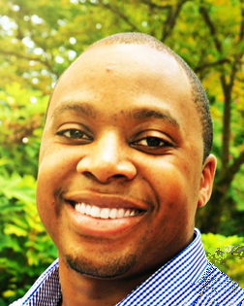
Marsalis Charles Production Supervisor Manager Tesla Fremont, CA
BSE Industrial Engineering,
Mercer University 2014
Mercer on Mission Environmental Engineer - Uganda, (Summer 2013)
Six Sigma Black Belt (December 2016)
Career Path
Industrial Engineer Intern, Blue Bird Corp. Fort Valley, GA 2013
Industrial Engineer / Lean Expert, PAS Technologies, Hillsboro, OH 2014 - 2017
Production Supervisor Manager, Tesla, Fremont, CA 2017-present

Slide 12
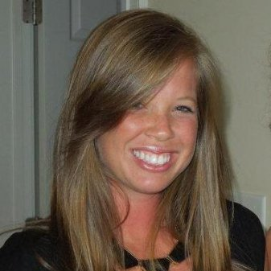
Stacey Odom Sr. Management Engineer Northside Hospital Atlanta, GA
BSE Industrial Engineering
MUSE 2010
Mercer on Mission Clinic Volunteer (Viet Nam, Summer 2009)
Performed clinical work such as giving injections, organizing paperwork, and assisted doctors during initial exams on patients
Developed and optimized ergonomic work flow system to efficiently move patients through each clinic
Career Path
Industrial Engineer, Robins Air Force Base. Warner Robins, GA 2010-2011
Management Engineer, Northside Hospital, Atlanta,GA 2011-2014
Senior Management Engineer, Northside Hospital, Atlanta,GA 2014-present

Slide 13
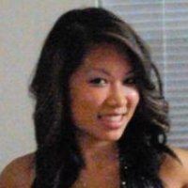
Jennifer Nguyen High Level Controls Sales Engineer Vanderlande Atlanta, GA
BSE Industrial Engineering
MUSE 2009
Magna Cum Laude
Tau Beta Pi
Institute of Industrial Engineers
Engineers without Borders
Career Path
Warehouse Manager, Pepsico - Frito Lay 2009-2010
Consultant, Manhattan Associates 2010-2013
High Level Controls Sales Engineer, Vanderlande, 2015

