Slide 1
ISE/IDM 288 Interview Kyle Adair
By: Jared Geha

Slide 2
Overview
Current Career
Education
Work Environment
Mercer Education Experience
Career Path
Life Outside

Slide 3
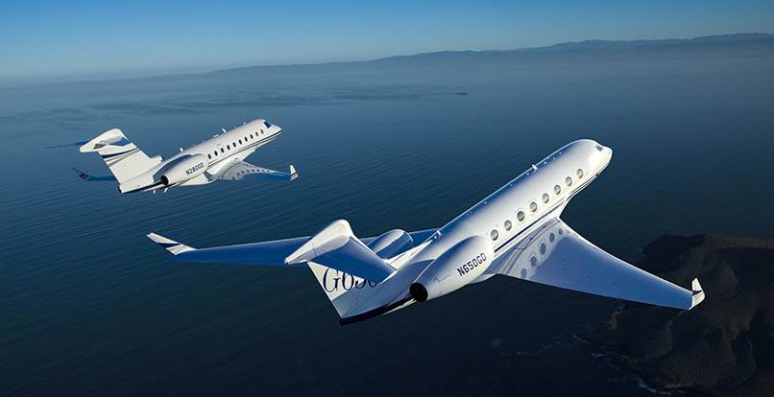
Current Career
Where?
Gulfstream Aerospace, Savannah Georgia
Current Job
Manufacturing Engineer

Slide 4
Education
Graduated From Mercer University December 2013
Bachelor of Science in Industrial Management
No licenses/ certifications (Black Belt, Certified Quality Engineer, etc) yet
Did not pursue a Master's degree

Slide 5
Education – Internships/Co-ops
None at Mercer
Directly following graduation
Received an internship at Gulfstream in January of 2014
9 month position and it opened the door for a full-time position
Manager was a Mercer graduate and was looking for a Mercer graduate for an internship

Slide 6
Work Environment – Routine
Normal work day routine
Shift is 6am to 4:30pm, Monday through Thursday
Team is composed of 4 people
98% group work
Provides support for Gulfstream's new aircraft in Completions. He creates work plans for furniture installation based off of the engineering drawing
About a 43 hour work week
Monday-Thursday

Slide 7
Work Environment – Skills/Competition
Essential Skills:
Rapid problem solving
In-depth knowledge of Lean Six Sigma and continuous improvement principles, the ability to work in groups, self-discipline/ time management, communication, and the ability to adapt to change.
Gulfstream is very competitive with over 12,000 local employees and 16,000 worldwide
Most stressful aspect – Fighting multiple fires at once
8-9 issues at one time any day
Always a tight schedule with a multi-multi-million dollar aircraft

Slide 8
Work Environment
Interactions outside the Engineering world
Works as a liaison on the shop floor – Goal is to build aircraft so he supports technicians
Errors like wrong materials, CAD errors, etc
Will step in and find a solution

Slide 9
Work Environment - Communication
Presentations
“Every email is in its own way a small presentation”
Coordinating with multiple departments, being able to document and communicate clearly and effectively is key
Engineering, materials, stockrooms, shop floor, production, etc.
“Dr. Burtner would have our class make a short power point for some of our projects and this was excellent training for the work place”

Slide 10
Work Environment – Expectations vs Reality
Job experience is slightly different than initial expectations
Mercer’s small class atmosphere and relationships with professors is unlike the workplace.
Bigger group sizes is the cause, preventing similar interactions

Slide 11
Mercer Education Experience
Mercer did an excellent job with preparing for the job
Classes/ curriculum were spot on, but professors and their real world exercises was the best
Most useful class: Anything from Dr. Burtner/ Senior Design
Least helpful classes: Industrial Manufacturing Techniques

Slide 12
Career Path
Has this been your career path since graduation?
Started a 9 month internship
Became an ME I with Completions Ops Planning in September 2014
Same role today and will be up for a ME II promotion in January 2017

Slide 13
Career Path
What made you choose the engineering field?
Loved playing with Legos as a kid
Loves problem solving
Engineering granted the opportunity to do that every day
Would you change your path if you could?
Would not
Where do you see yourself in 5-10 years from now?
Still in Savannah and at Gulfstream moving up for 5 years. The next 5 may see change – Interest is in health care as well

Slide 14
Life outside
Monday-Thursday workday offers a lot of free time
No work on weekends
Recently got married in August 2015
Wants to spend as much time with family and 4 10 hour shifts makes this possible

Slide 15
Do you give us permission to publish your contact information on Dr. Burtner’s website?
Yes
Do you give us permission to publish your interview responses on Dr. Burtner’s website?
Yes
Gulfstream very strictly prohibits workplace pictures due to their security policy

