Slide 1
About Me - BioPoem
BioPoem:
- I chose ISE/IDM because I think there is always room for improving processes.
- I enjoy designing cars.
- I get in trouble when I do not give all my effort all the time.
- I have a habit of scribbling on everything.
I would like to be remembered as adventurous.
Tyler Smith BioPoem January 2018 Slide 1

Slide 2
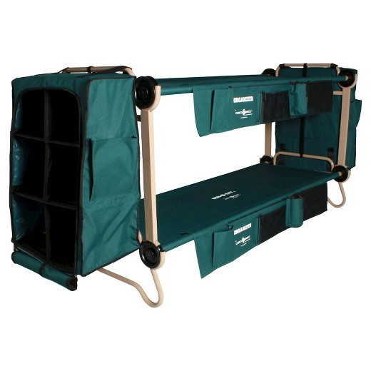
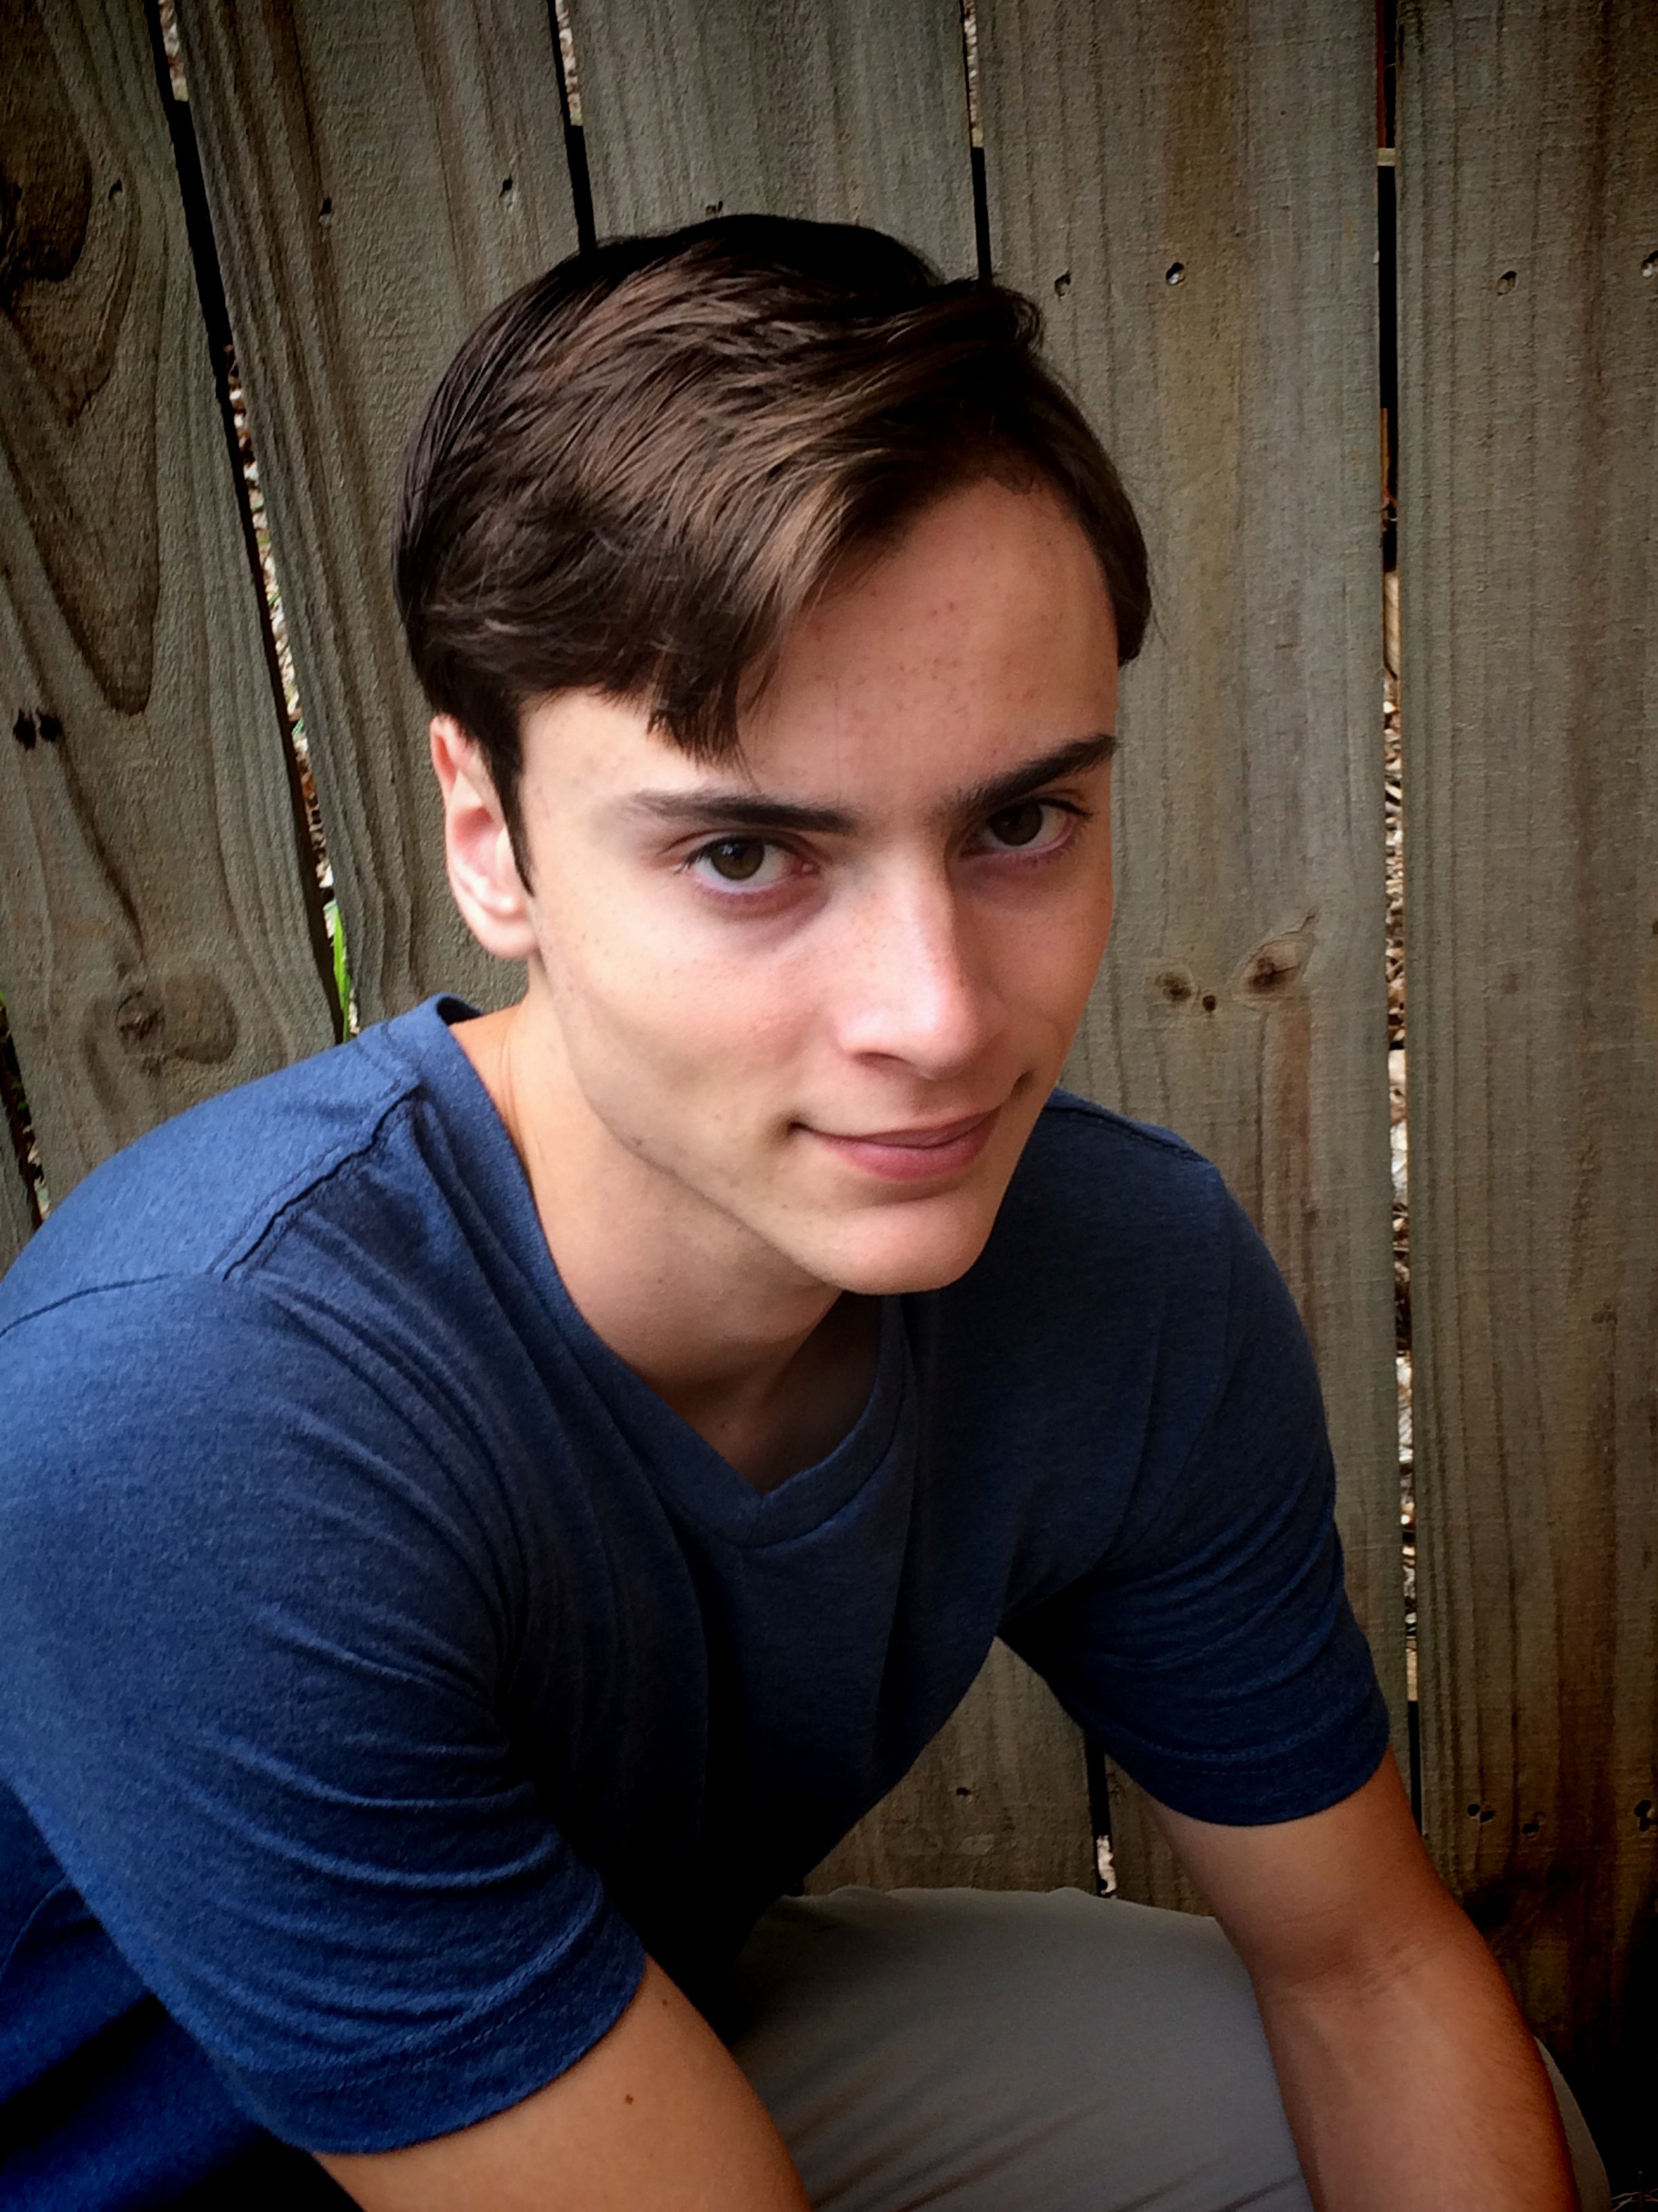
About Me - Pictures
Professional/Academic
Personal/Family
I attend Mercer University.
This is a photo of the Disc-O-Bed bunk. I am helping them design a pet version.
This is a photo of me.
Tyler Smith BioPoem January 2018 Slide 2

