Slide 1
Health Cost by Cost Center of Inpatient Hospitalization for Medicare Patients Undergoing Major Abdominal Surgery
ETM 568 ISE 468
Spring 2015
Matt Fenstemacher
Alesia Ginn
Weslie Williford
Hospital Costs by Cost Center of Inpatient Hospitalization for Medicare Patients Undergoing Major Abdominal Surgery, Stey, Anne M., Brook, Robert H., Needleman, Jack, Hall, Bruce L., Zingmond, David S., Lawson, Elise H., Ko, Clifford Y.,Journal of the American College of Surgeons , Volume 220 , Issue 2 , 207 - 217.e11. Web. http://www.journalacs.org/article/S1072-7515(14)01795-5/abstract Retrieved 6 Feb 2015

Slide 2
Overview
Cost of 3 common abdominal surgeries, colectomy, cholecystectomy, and pancreatectomy.
3 goals of the paper
Evaluate the distribution and magnitude of cost incurred from a procedure.
Examine if the length of stay and other factors played a part in the overall cost.
To determine if there was variation in cost across the different hospitals.
2015
Presented by Matt Fenstemacher, Alesia Ginn, and Weslie Williford
Slide 2

Slide 3
Methods
Data Sources and Measures
Clinical Data Source: The clinical data source was the American College of Surgeons' National Surgical Quality Improvement Program (ACS-NSQIP).
Administrative Data Source
Medicare Cost Reports: An annual compilation of all hospitals’ reported costs and charges by cost centers.
Primary Outcome
The primary outcome was the estimated cost of the inpatient surgical hospitalization from the hospitals perspective.
2015
Presented by Matt Fenstemacher, Alesia Ginn, and Weslie Williford
Slide 3

Slide 4
Methods
Patient Sample
27,971 patients were identified as Medicare beneficiaries, 65 years and older.
6, 048 patients were excluded due to emergency surgery
21,923 patients were chosen( 13,945 colectomy, 5,569 cholecystectomy, 2,409 pancreatectomy).
Statistical Analysis
Descriptive statistics of patient case - mix severity measures, comorbidities, and costs were performed.
To help explain some of the variation in cost from metropolitan to rural areas and of patients that had no complications and those that did, further statistical comparisons were performed.
2015
Presented by Matt Fenstemacher, Alesia Ginn, and Weslie Williford
Slide 4

Slide 5
Results
Patient case-mix severities and comorbidities associated with costs-> (estimate 1.72, 95% CI 1.57 to 1.87) dependency on functional status-> (estimate 1.63, 95% CI 1.53 to 1.74)
Hospital Costs by Cost Center of Inpatient Hospitalization for Medicare Patients Undergoing Major Abdominal Surgery, Stey, Anne M., Brook, Robert H., Needleman, Jack, Hall, Bruce L., Zingmond, David S., Lawson, Elise H., Ko, Clifford Y.,Journal of the American College of Surgeons , Volume 220 , Issue 2 ,p.214. Web. http://www.journalacs.org/article/S1072-7515(14)01795-5/abstract Retrieved 6 Feb 2015
2015
Presented by Matt Fenstemacher, Alesia Ginn, and Weslie Williford

Slide 6
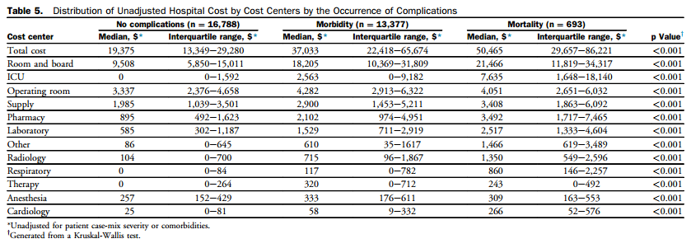
Results
Below is a table showing the distribution of hospital costs by cost centers in correlation to the occurrence of postoperative complications.
Hospital Costs by Cost Center of Inpatient Hospitalization for Medicare Patients Undergoing Major Abdominal Surgery, Stey, Anne M., Brook, Robert H., Needleman, Jack, Hall, Bruce L., Zingmond, David S., Lawson, Elise H., Ko, Clifford Y.,Journal of the American College of Surgeons , Volume 220 , Issue 2 ,p. 215. Web. http://www.journalacs.org/article/S1072-7515(14)01795-5/abstract Retrieved 6 Feb 2015
2015
Presented by Matt Fenstemacher, Alesia Ginn, and Weslie Williford
Slide 6

Slide 7
Discussion
Room and board costs accounted for nearly half of all costs and were highly correlated with length of stay.
Multivariate analysis demonstrated that patient case-mix severity, comorbidities, and procedure type were correlated in expected ways with hospital costs.
The data presented in the study allows someone, regardless of position at the hospital to evaluate where cost is incurred from various procedures and may allow for them to evaluate where cost can be reduced.
2015
Presented by Matt Fenstemacher, Alesia Ginn, and Weslie Williford
Slide 7

Slide 8
Limitations of the Work
Patient sample was exclusively Medicare patients 65 years and older who sought inpatient care at ACS-NSQIP hospitals.
Professional fees were not included and therefore the cost are underestimated.
The data used was publicly available Medicare cost-to-charge ratios, and may not be accurately reported to the cost centers from the hospitals.
2015
Presented by Matt Fenstemacher, Alesia Ginn, and Weslie Williford
Slide 8

Slide 9
Conclusion
The cost of 3 common elective operations from 202 hospitals were evaluated.
The cost varied as expected based on the type of surgery and comorbidities.
A significant variation in cost was concluded even after taking in to account various factors.
The hope is that this evaluation of data will encourage hospitals to improve the value of care without sacrificing quality.
2015
Presented by Matt Fenstemacher, Alesia Ginn, and Weslie Williford
Slide 9

